Slide 1

CLC
Career life Connections
Ms. Gillam
&
Ms. Lo

Slide 2
Welcome to CLC!
"this is stupid. Why am I here?"
Welcome to CLC 11!
CLC is a MANDATORY course that you need to graduate.
M.A.N.D.A.T.O.R.Y
No completion of CLC means no diploma. #sorrynotsorry
CLC will occur during collaboration time in Semester 1 & 2
CLC classes will be done by either attending a presentation or workshop at the school or by doing an assignment online through Office 365 or MyBlueprint.

Slide 3
Online or in person?
Refer to the sheet given to you about how to log on.
You will attend CLC on collab days by attending a presentation or workshop in school or by completing an online assignment.
All presentation options, sign-ups and assignment will be available through Office 365 or MyBluePrint.

Slide 4
LOG IN INFORMATION
Office 365
Link to Office 365 is on the Alpha Website
Your login in email is your student number@edu.burnabyschools.ca (123456@edu.burnabyschools.ca)
If you do not remember your password or are having difficulties logging on, please see Ms. Cao in the office.
Once you have logged on you will see a number of Microsoft apps. The CLC 11 group is under teams. Once you are in the teams section you will be able to click on Files. Files is where you will find presentation information, sign up information and assignments.
Conversations is where you will be able to see updates and messages from Ms. Gillam or Ms. Lo
MybluePrint
Search www.myblueprint.ca/sd41
Sign up!
Step 1. Go to SIGN UP
Step 2. Enter ACTIVATION CODE bbyalpha
Step 3. Select STUDENT
Step 4: Complete registration and enter information. (This needs to be professional and accurate).
Once you have signed up, we will place you in a virtual class. Through this CLC 11 Class you will be able to receive messages from Ms.Gillam or Ms.Lo as well as find all information about MybluePrint specific assignments.

Slide 5
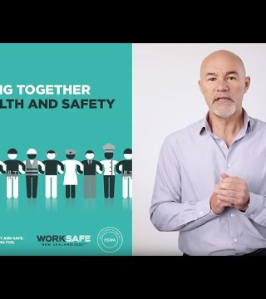
PRESENTATIONS
You must attend a MINIMUM of 3 presentations during the course of CLC 11.
Sign up details and information on the presentations will be available on Office 365.
You will sign up for them like you did for today's session.
There will be some sessions that every student must attend. Those do not count as one of the minimum three.

Slide 6
assignments
For each day & session of CLC 11 there will be an assignment that must be completed.
On days that you do not attend a presentation at school you will be required to complete the assignment online.
Assignment details and submission will be on
Office 365 or MyBluePrint.
Check both sites often for updates!

Slide 7
Clc 11
"What are we even doing?"
CLC Semester 1
Office 365 & MybluePrint
WorkSafe BC
G&F Financial

Slide 8
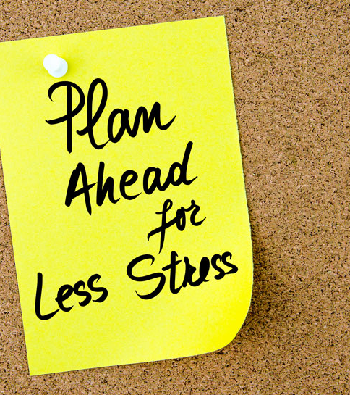
Last minute reminders
Follow the steps on your sheet to sign up for Office 365 & MybluePrint.
Sign ups for presentations, presentation options and assignment details will be there.
Check both sites often for reminders, as well as listen to the announcements and check the student bulletin.

Slide 9
Wednesday oct 31st
The The first available presentation option is coming up next Wednesday, October 31st!
Michael Lovett from WorkSafe BC will be coming in to share his story.
There are 60 available spots.
Sign up for this session will be open on Thursday Oct 25th

Slide 10

Final thoughts
If you think that there is a better way to share information about CLC with all of you please let us know!
Ex: Instagram page?
We are here to help, not make things worse. Promise.
Prizes, candy, and fun stuff to come!
Participation is a MUST!
Thank you!

