Slide 1
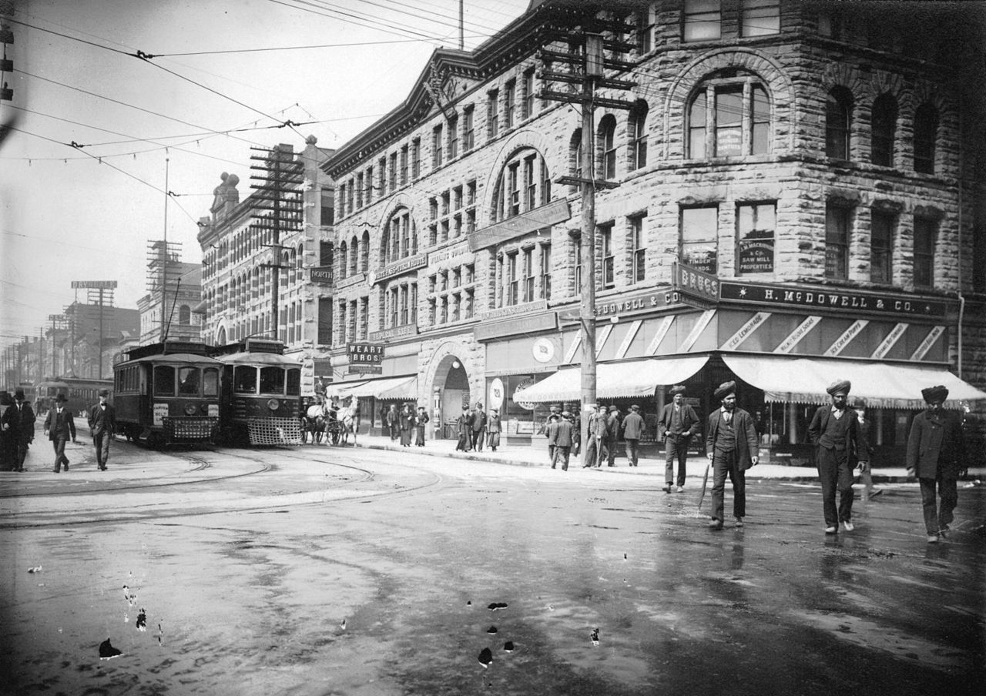
Socio-cultural impact of South Asian Canadian communities in Canada
Dr. Satwinder Kaur Bains
Director, South Asian Studies Institute
University of the Fraser Valley
Associate Professor, Social Cultural Media Studies
May 3, 2021

Slide 2


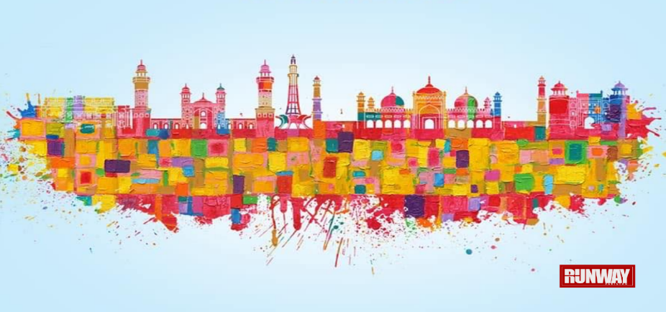
OVERVIEW:STUDY OF SOUTH ASIA/SOUTH ASIAN
Arrival/settlement/integration (1903 onwards)
Who lives in the diaspora (4 groups)
Community (research)

Slide 3
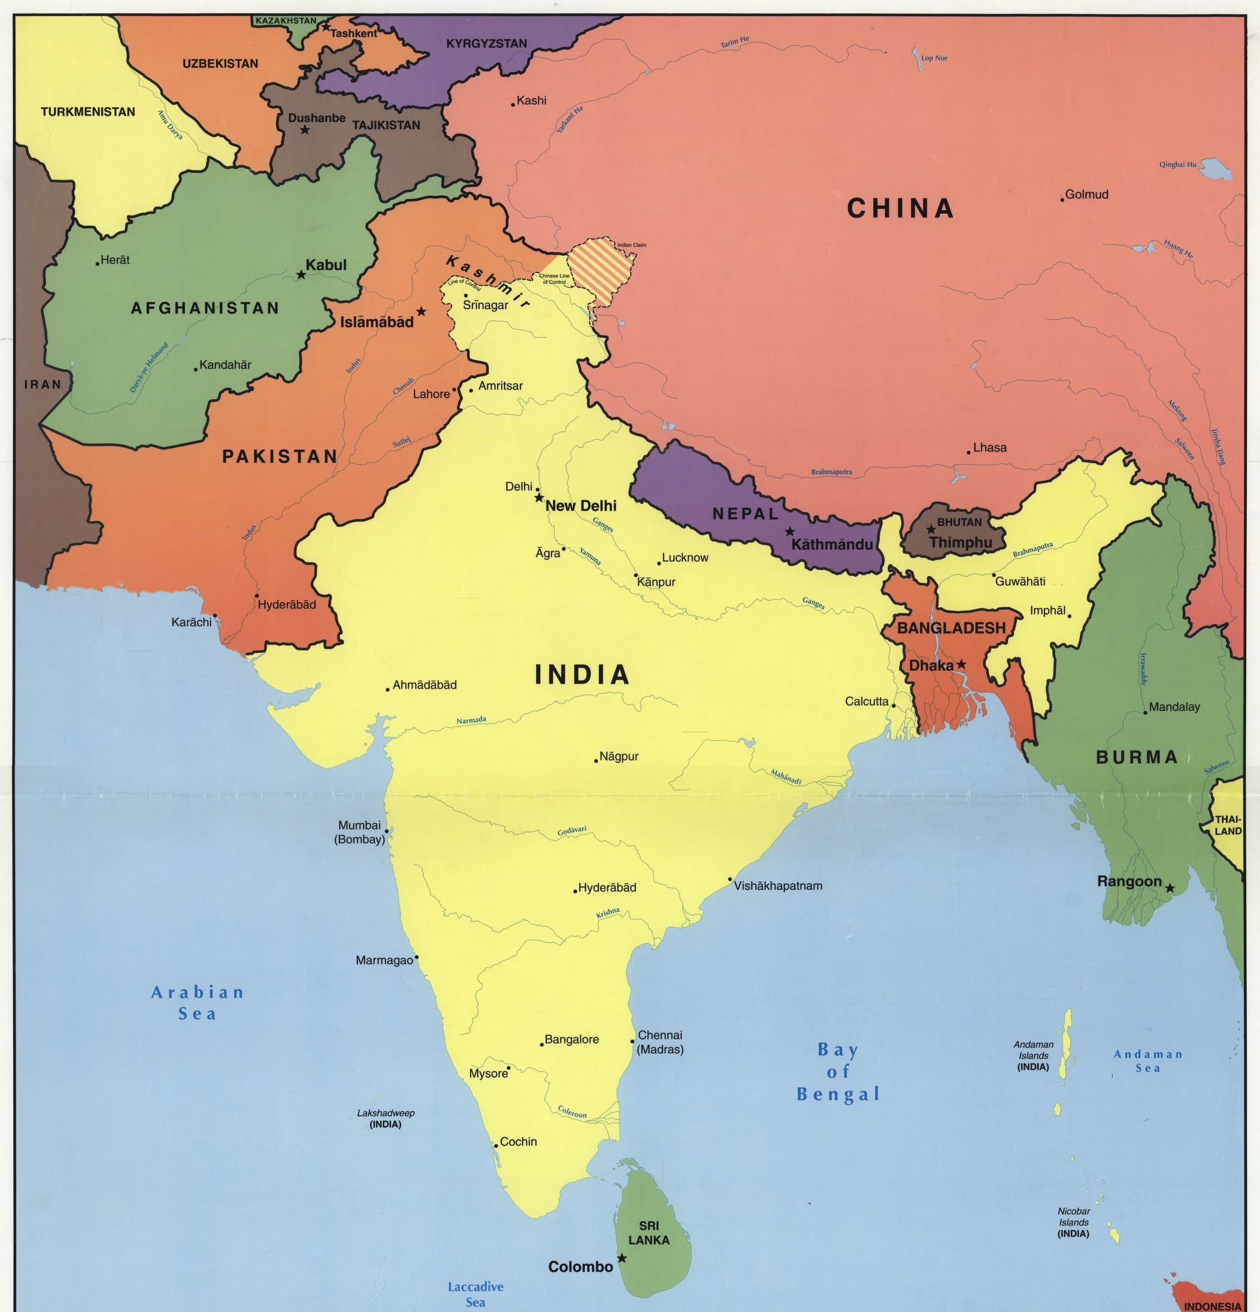
So, what is South Asia?
8 countries
Bhutan 778,568
Sri Lanka 21.8 million
Nepal 28.61 million
Afghanistan 33.7 million
Mayanmar 54.7 million
Bangladesh 164.69 million
Pakistan 208.57 million
India 1.36 billion
TOTAL 1,872,480,000 billion
Canadian diaspora 1,963,330 million
Hyphenated Canadians?

Slide 4

Framing of sociocultural histories (social impact)
The story of the “west”
The west as “journey”
The west as “destination”
The west as “temporary”
The west as “daughter colony”
The west as “foreigner/settler/migrant”
The west as “erasure/omission/neglect”

Slide 5
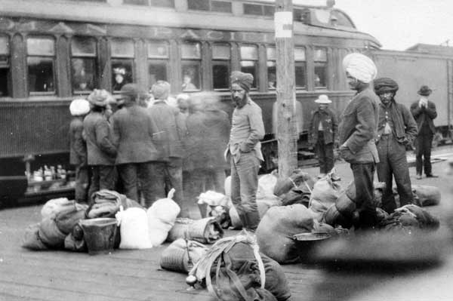
1897-2021 124 years of trials, tribulations, successes
1904-1908 | 5,179
1904-1906 | 432
1906-1907 | 2,124
1907-1908 | 2,623
2016 census:37,915 Abbotsford
287,900 Vancouver
995,125 Toronto
122,515 Calgary
90,815 Montreal
91,595 Edmonton

Slide 6
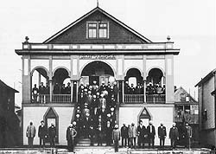
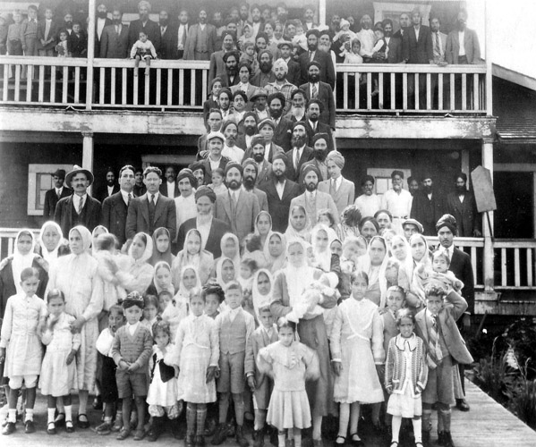
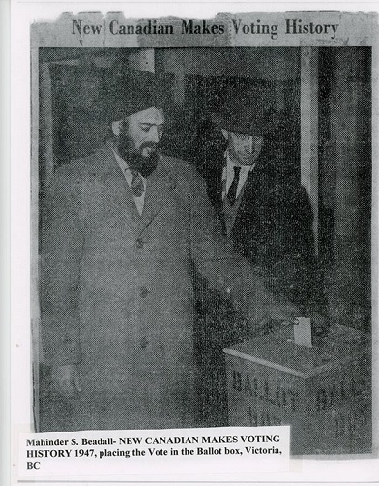
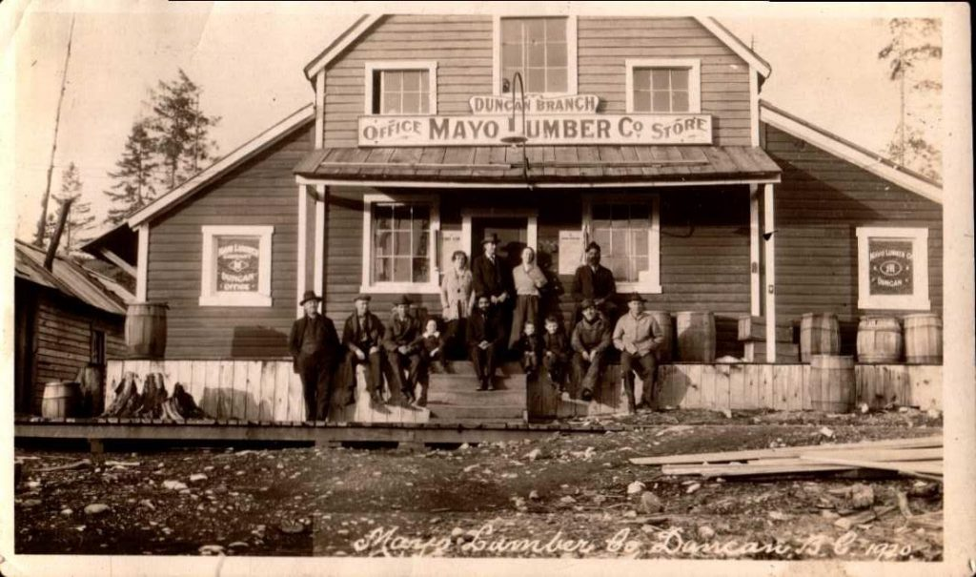

Slide 7
FILMS ON PUNJABI HISTORY
https://www.youtube.com/watch?v=br3BA5cckRo
https://www.youtube.com/watch?v=6t6s8g7Kqlk

Slide 8
COMPLIANCE, IDENTITY, INTERNALIZATION and INFLUENCE
THE EARLY YEARS
THE QUIET YEARS
BUILDING COMMUNITY
SETTING DOWN ROOTS
WINDS OF CHANGE
NETWORKS AND ACTIVISM
SOCIETY
HOME
HOST
LAW
COLONY

Slide 9
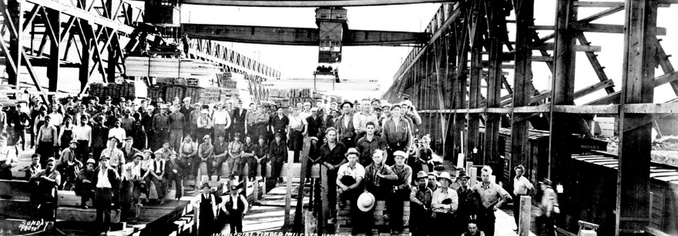
CURATING HISTORY
“INJUSTICE – STRUGGLES AND TRIUMPHS”
ECOLOGY OF COMMUNITY: SMALL TOWNS AND BIG CITIES

Slide 10
IMPACT, INFLUENCE AND INSPIRATION
PAST PRESENT FUTURE
ECONOMICS, POLITICS, CULTURE
Memory recollected
History is relevant and supported
Today’s issues are addressed
Working to ensure we leave a legacy
What about the future?
What is our impact?
How do we influence
What about culture, language, heritage and society
What stories do we bring with us – what do we leave behind?

Slide 11

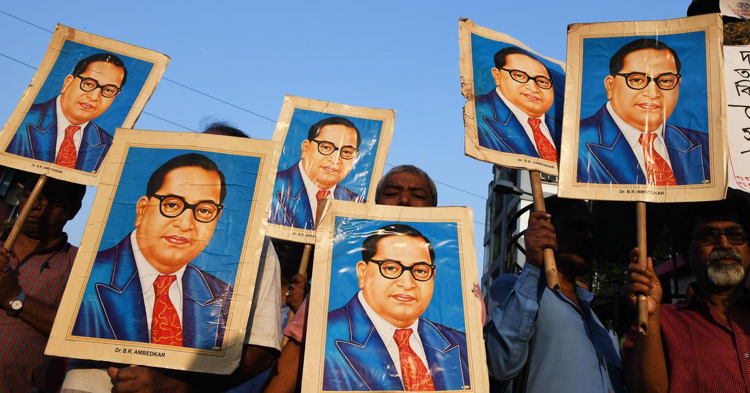
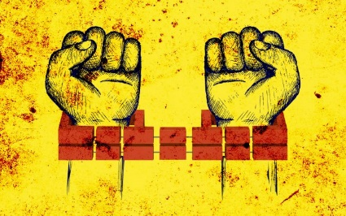
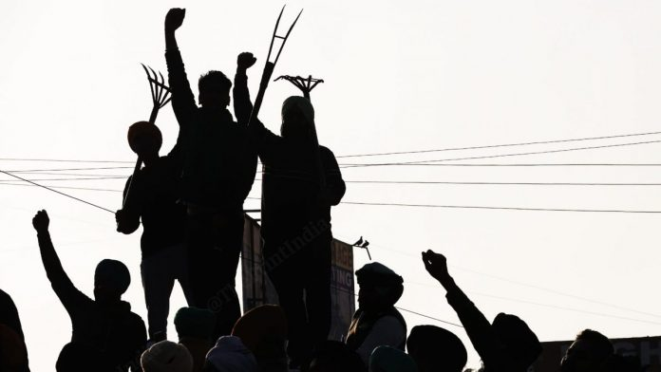
THE QUESTION OF SOLIDARITY and ACCOUNTABILITY
Immigrants and Indigenous Truth and Reconciliation
Different groups/similar experiences
Redress as a movement
The race revolution
Protest as activism

Slide 12
Community engagement as practice
SOUTH ASIAN CANADIAN LEGACY PROJECT
South Asian CanadianDigital Archive: artefacts, photos, texts, materials, oral histories etc.
Historic Sites: Public awareness of 15 sites recognized by BC Government.
B.C. Labour Movements Social Histories Research: Development of resources in partnership with BC Labour Heritage Centre.
Social History: Production of a public history book presenting South Asian Canadian social histories across British Columbia.
Learning Resources: Development of curriculum for K-12 schools in partnership with Open School BC.
Travel Exhibit: History Exhibit in partnership with the Royal BC Museum.
2020-2022

Slide 13
THANK YOU
Thank you……
Questions?
Satwinder.bains@ufv.ca

