Slide 1
APA CITATIONS
How to credit the sources you use in your projects & papers

Slide 2

Why?
https://www.youtube.com/watch?v=CDGdqoCyAtw

Slide 3
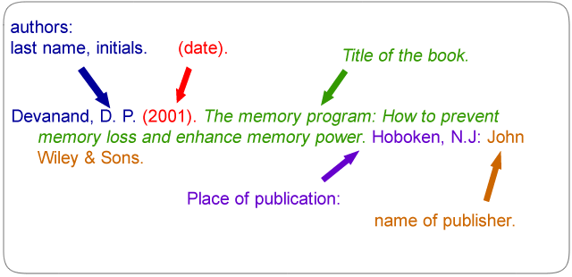
What information is needed?
A BOOK

Slide 4
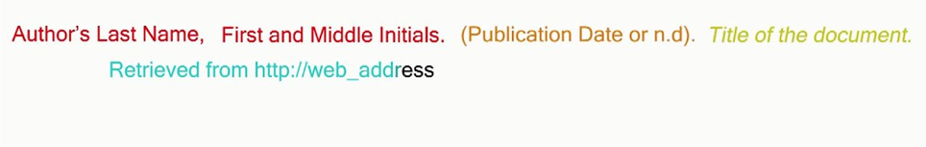
Retrieved from….
A website

Slide 5
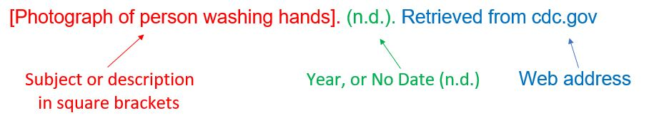
Media TYPE: Images, diagrams (Format)
Basic Format:
Artist Last Name, First Initial. Second Initial. (Year). Title of the artwork [Format]. Retrieved from URL
Image Without Author:
Title of work [Format]. (Year). Retrieved from URL
Image With No Author, Title, or Date
[Subject description and format]. (n.d.). Retrieved from URL

Slide 6
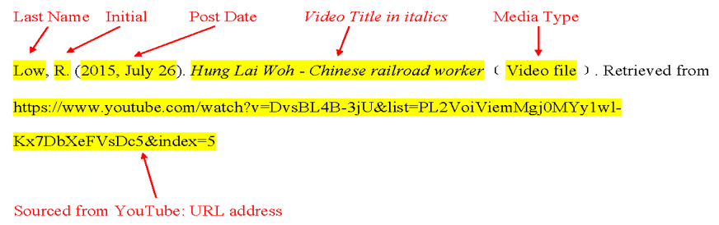
Media type: (video file)
A video

Slide 7
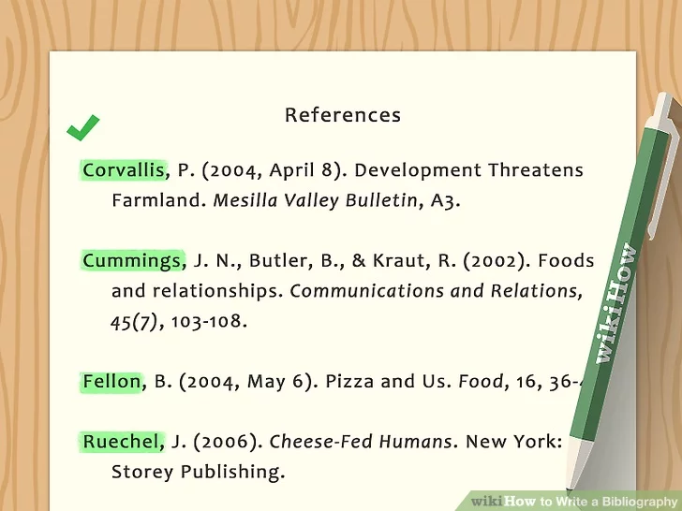
Put it all together….
Title is….References
Listed alphabetically
Indent any lines that continue after the first
Italicize the title
Double spaced
Last page of a report or essay

Slide 8


Pay close attention to….
Punctuation
Brackets and colons
Date format (year, month day)
Order of information
Spelling

Slide 9
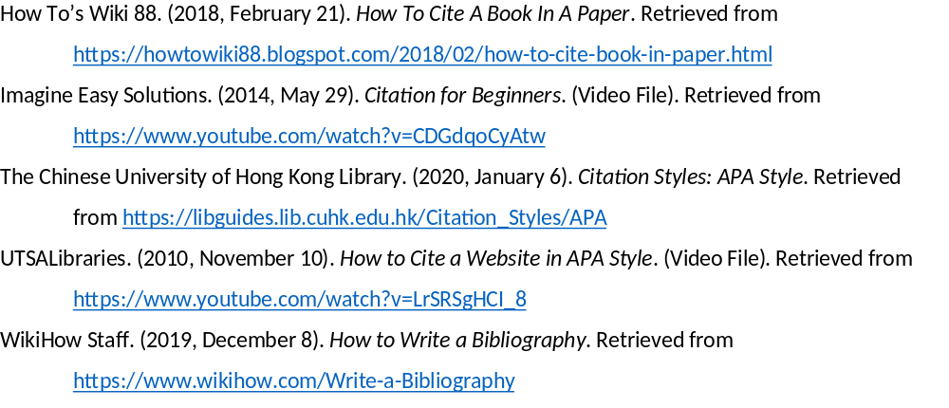
references

