Slide 1
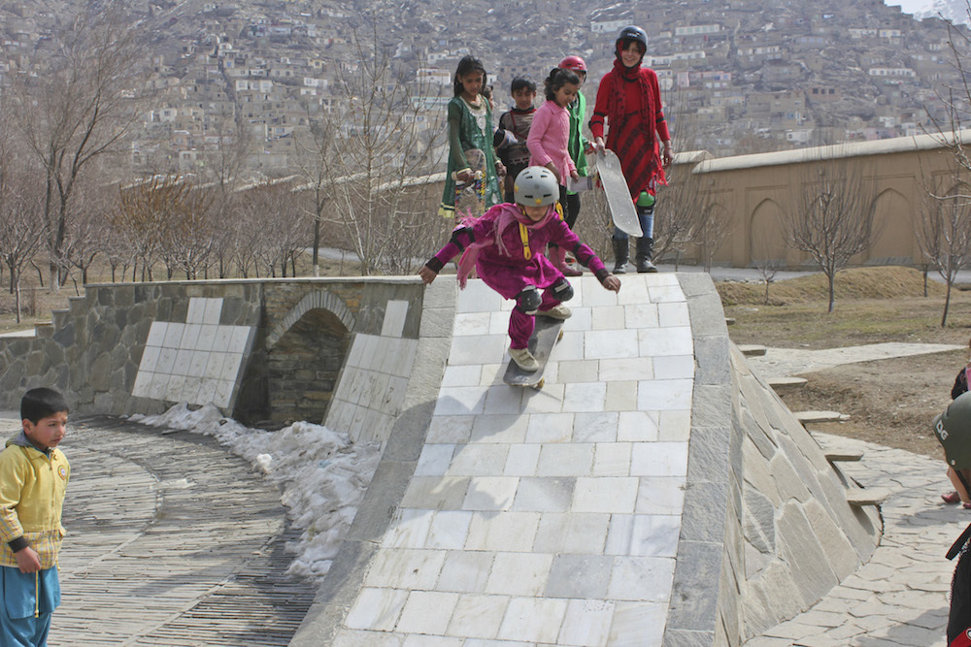
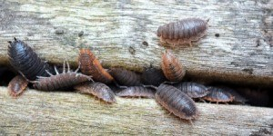
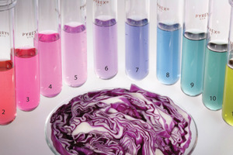
Using Hands on Inquiry to Develop Competencies in Science and Math

Slide 2
Agenda
1.What’s new in Science and Math?
2. What is Inquiry
3. Stations—a few explorations
4. Connections to the Curricular Competencies
5. Questions/Needs

Slide 3
What’s new in Science?
Topics rearranged to be developmentally appropriate
Emphasis shifted from KNOW to DO (curricular competencies—which are the skills and processes—have become the more important part of the curriculum).
Place-based learning is prescribed throughout the science curriculum
Scientific Inquiry is prescribed

Slide 4
What’s new in math?
Slight revision to content topics to be developmentally appropriate, but not as much as science
Emphasis on DO (curricular competencies) particularly problem solving
Financial literacy thread from K-12
Addition of Indigenous perspectives

Slide 5
What is Inquiry?
Opportunity for students to develop their own questions, to design ways to investigate those questions, to carry out those investigations, and to reflect and evaluate those investigations to develop further inquiries.

Slide 6
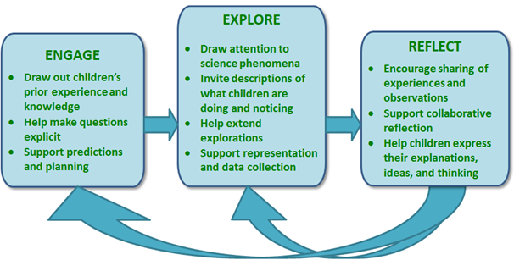
The Inquiry Cycle--EER

Slide 7
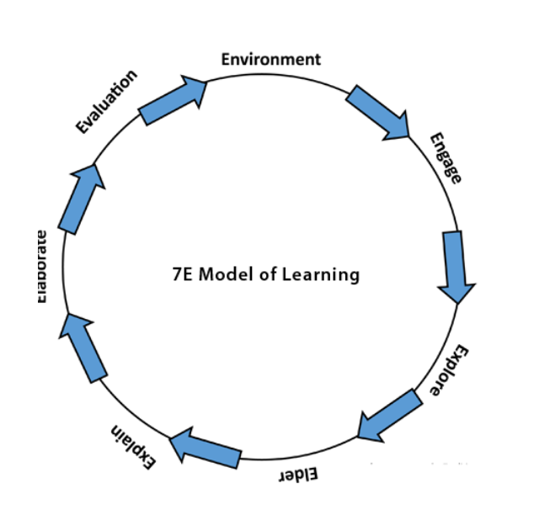
The Inquiry Cycle—7 E

Slide 8
Stimulating Inquiry
Setting up some materials and “provocations” as they are called in math, we can get students engaged and then have them initiate their own inquiry. Why is this important?

Slide 9
Activity Stations
Rotate to the different stations.
What questions might you have? How can you help students generate questions?
Use the hand-out. If you have done these activities before, use the chart sheets at each station to give us some further tips and techniques.

Slide 10
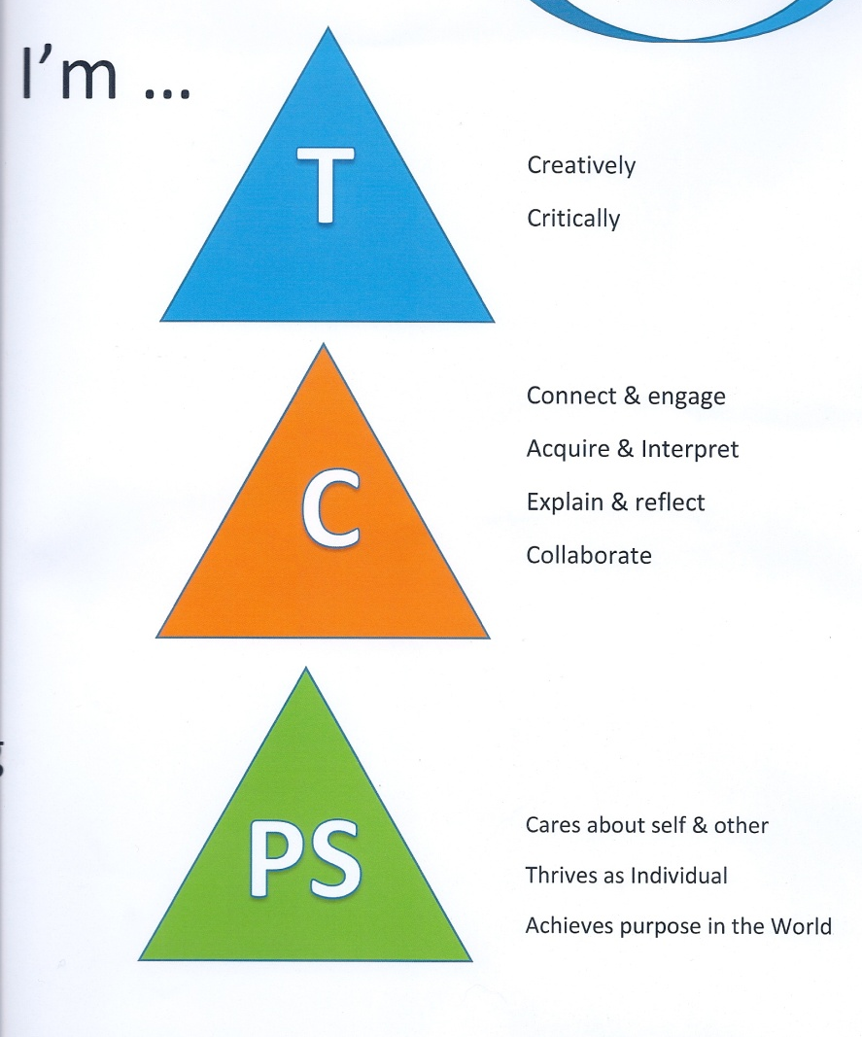
Connecting the Competencies
Pick up the curricular competency for a grade of math and/or science that you teach.
Two tasks:
Use a highlighter to connect the curricular competency with a core competency
Underline curricular competencies that could be explored, learned and assessed through inquiry

Slide 11
What do you need?

Slide 12
Coming up in Science and Math
Nov 7—Carole Fullerton
Nov 16—Science Fairs/Celebrations
District Day—what do you want?
Call me! I would love to come to your school and classroom to help plan and implement the new Sci and Math curricula!
Donna.Morgan@sd41.bc.ca

Slide 13
Useful Resources
“Productive Talk” (Primary): http://ltd.edc.org/using-video-analysis-support-preschool-science-and-language-teaching-part-2
Inquiry Based Science (Video and/or transcript for visual learners): https://www.edutopia.org/practice/inquiry-based-learning-science-classroom

