Slide 1
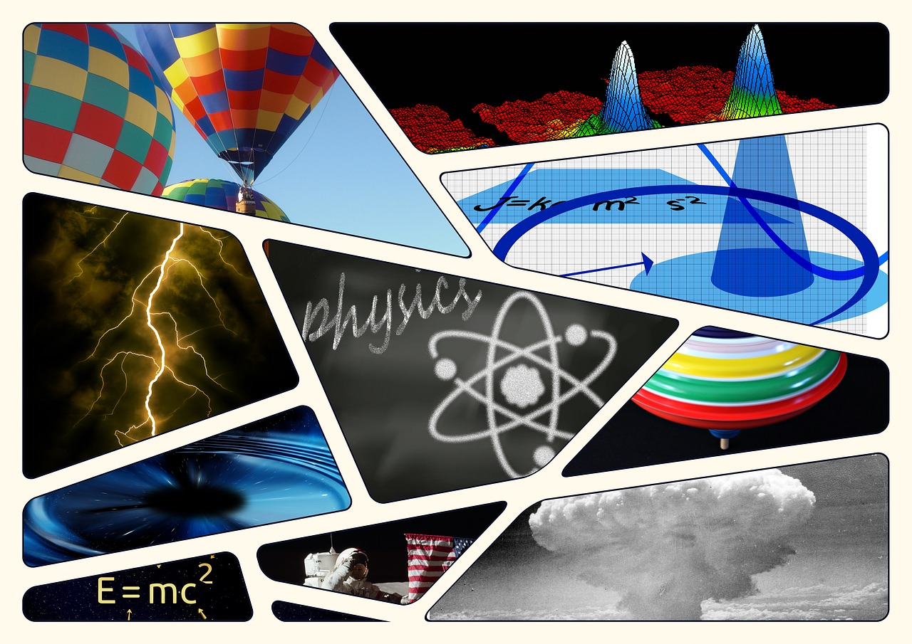
Science Fairs as Inquiry

Slide 2
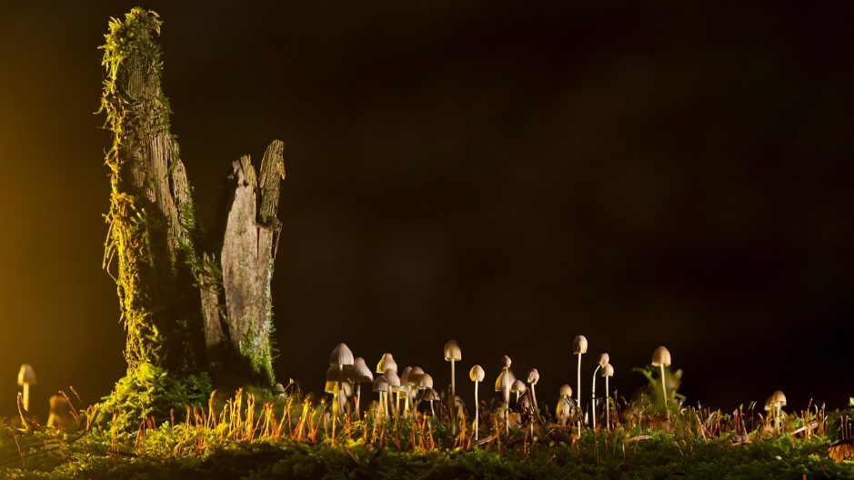
Agenda
Relationship to Inquiry
Types of Projects
The 7 E’s
Getting Project Ideas
Judging or presenting?
What do you need to get started?
Documents and Links

Slide 3
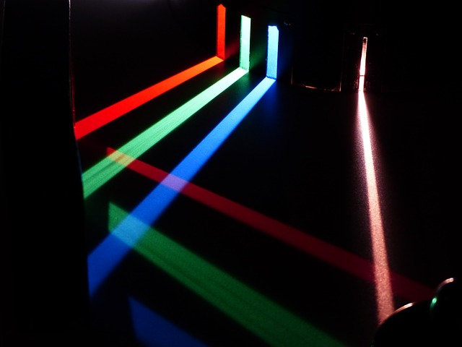
Relationship to Inquiry
What are the characteristics of Inquiry?
A Need to Know/A driving question
Student Voice and Choice
Exploration beyond a book
A Meaningful Product
Do science fairs meet the criteria?
Notes:
The key requirement of inquiry is that it is meaningful to the students. The beauty of a science fair project is that rather than setting the project up for the students, the student chooses the topic and goes with it. This takes the most difficult task—finding an engaging topic—out of the teacher’s hands and into the students.

Slide 4
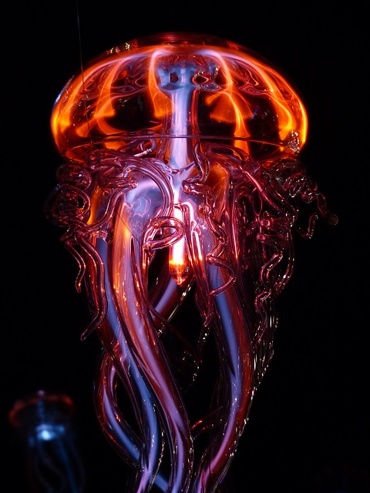
Types of Projects
Level One: Research Report
Level Two: Model
Level Three: Collection
Level Four: Simple Experiment or Study
Level Five: Innovation or Complex Experiment or Study
Level one two and three are more for primary; level three, four and five are for intermediate and secondary.
Can you think of examples of each type of project?
Notes:
Level One: Research Report
-This project focuses on research and reporting out findings already available. It could be “Monarch Butterflies” or “How Oil Spills Occur”.
Level Two: Model
-This type of project focuses on building a model of some scientific invention or natural phenomenon. This is where a “model volcano” or “the Enigma Machine” would be done.
Level Three: Collection
-This project involves collecting materials and tying them together with some important observation. For example, collective leaves of the same type of trees from busy streets and streets with less traffic, and looking at differences. Or collecting rocks from different areas and comparing the shapes and compositions.
Level Four: Simple Experiment or Study
-A simple experiment or study answers a question by designing an experiment or correlating existing data with one or two variable factors. For example, the rate of corrosion of metals under different temperatures and humidity levels.
Level Five: Innovation or Complex Experiment or Study
-A sophisticated experiment where you control all possible variables where results cannot be attributed to error or variance and can be documented. This type of work will lead to more questions and further research. An innovation would be the design of some new apparatus or process that is then tested (for example, how can you design collapsible bumpers for cars that reduce accident damage). A study would correlate very different data, although the data is gathered from on-line or text sources (for example, is the incidence of BC forest fires correlated with high Pine Beetle infestations).
Level one two and three are more for primary; level three, four and five are for intermediate and secondary.

Slide 5
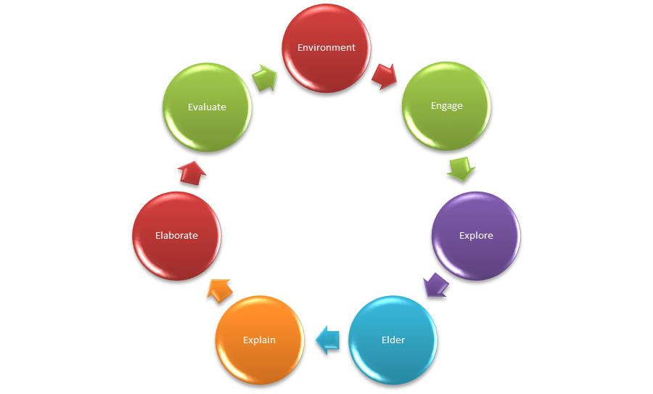
Process—The 7 E’s

Slide 6
Environment
Students take the opportunity to learn traditional ecological knowledge (TEK) through place based activities. Have students walk and observe their environment (outdoors or even inside their homes) to pick topics that have meaning for them.
Engage
Students become engaged begin to develop their own questions, build curiosity and thread together ideas to solve big ideas. Students focus on one area of curiosity.
Explore
Students began to explore their area of learning with text resources, internet and interviews, students began to learn how their questions were related and formulate a “story of understanding” around the science.

Slide 7
Elders
Students worked side by side with experts, elders and cultural facilitators to develop models and greater understanding around their topic. This might even involve working with some older students.
Explain
Students either conduct their experiment or gather their observations/ information and prepare to put together their results and findings. It is often very useful to have students keep a diary or log book of their projects, so they can trace their learning from the early stages to the completed project.

Slide 8
Elaborate
Students complete their projects, using criteria given by teacher. This may be done “Science Fair” style or “Science Celebration” style.
Evaluate
This can refer both to self assessment, and to an assessment using criteria supplied by the teacher. See links for various types of assessment.
From FNESC Science First Peoples

Slide 9
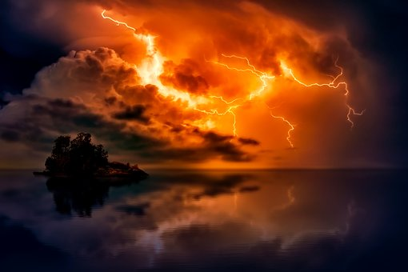
Generating Project Ideas
-Kids own questions are the best—come up with UNIQUE ideas
-Use a brainstorming process
-Science Buddies has a project idea generator that takes into account age, interests and abilities.
https://www.sciencebuddies.org/science-fair-projects/topic-selection-wizard/background-info

Slide 10
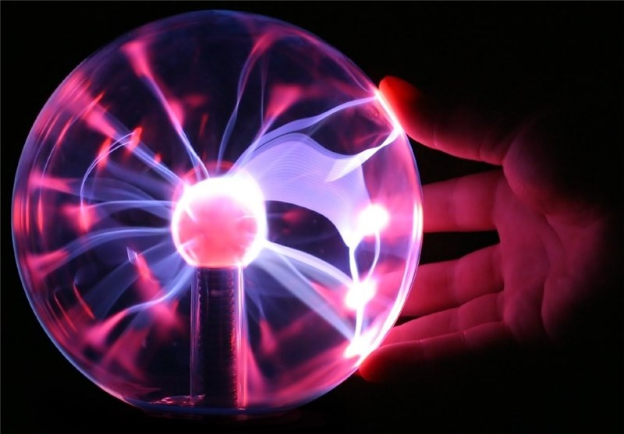
What is a Science Celebration Versus a Science Fair?
On the surface, the projects at the two events may be identical. The differences come in the way the event is organized and the priorities of the organizer. In a Science Celebration, learning, teaching, sharing and enjoying science is the priority; for many in a traditional science fair, impressing an adult judge is the priority. The good news is that anyone who is beginning the Science Fair process in an elementary school can shift to the Science Celebration model.

Slide 11

What would you need to get started?
What barriers might be in the way?
What kind of support do you want?

Slide 12
Key Links
Science buddies: https://www.sciencebuddies.org/teacher-resources/science-fair-tools
GVRSF: Guide by Jully and John Shim (Jully is a Burnaby North teacher): http://www.gvrsf.ca/images/Documents/Science%20Fair%20Handbook%20by%20John%20Shim.pdf
Guide to celebrations: http://www.gvrsf.ca/images/Documents/Science%20Celebration%20by%20Len%20Reimer.pdf
FNESC Handbook (includes planning guide for Shared Knowledge Science Celebration on p 195): http://www.fnesc.ca/wp/wp-content/uploads/2015/08/PUBLICATION-61496-Science-First-Peoples-2016-Full-F-WEB.pdf

