Slide 1
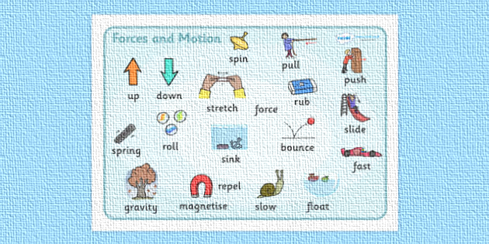
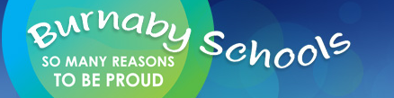
FORCES—through an inquiry lens
Donna Morgan
Math/Science Consultant

Slide 2
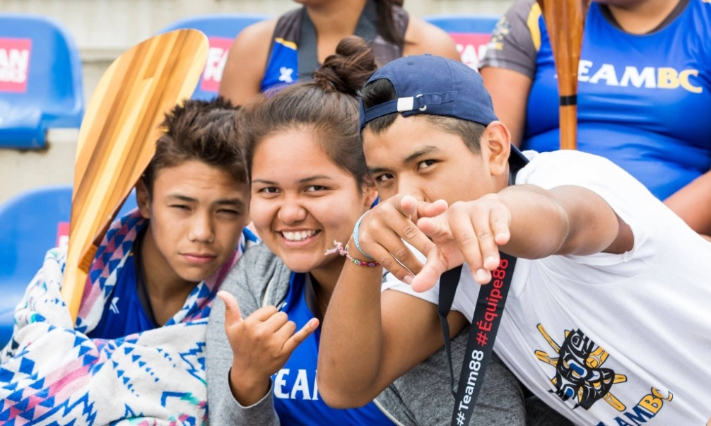
Acknowledgement
We acknowledge the traditional, unceded territories of the Coast Salish peoples, the Musqueam, Squamish and Tsleil-Waututh peoples on whose land we live, learn and work.

Slide 3
Session Objectives
Develop an overview of FORCE CONCEPTS as they build through the K-7 curriculum
Learn some lab invitations, hands on inquiry and some discrepant events to stimulate thinking.
Develop a technique to help students generate their own inquiry questions
Weave Indigenous perspectives into the teaching of these topics
Make cross curricular connections with FORCE topics
Integrate the curricular competencies and learning standards into a unit on these big ideas

Slide 4
Agenda
Acknowledgement
Introductions
Overview of FORCE (20 min)
3 simple force activities as invitations to think (15 min)
Developing student questions (20 minutes)
Grade Level Groups—curriculum overview (4 pagers)-Read and Reflect (15 min)
SUPPER BREAK: 5:15 (30 min)
Hands On Play and Experimenting (30 min)
Tying it together—inquiry ideas/planning framework/assessment (10 min)
Feedback/Prizes

Slide 5
OUR BIG IDEAS TODAY
K: The motion of objects depends on their properties.
Gr 2: Forces influence the motion of an object.
Gr 5: Machines are devices that transfer force and energy.
Gr 6: Newton’s three laws of motion describe the relationship between force and motion.
Gr. 7: The electromagnetic force produces both electricity and magnetism.

Slide 6
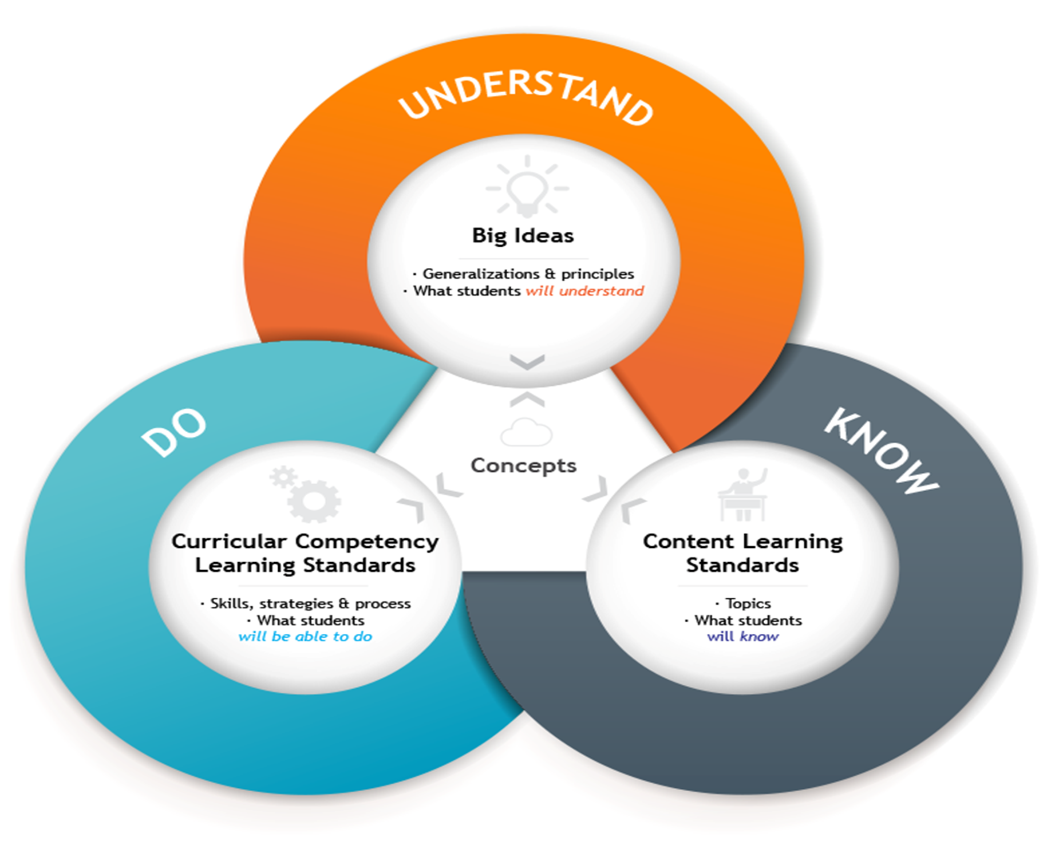

Slide 7
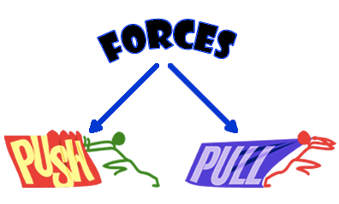
WHAT IS A FORCE?
A force is a push or a pull. It is measured in Newtons (N).
Forces act in pairs and they always act in a certain direction.
Forces can't be seen, but their effects can.

Slide 8
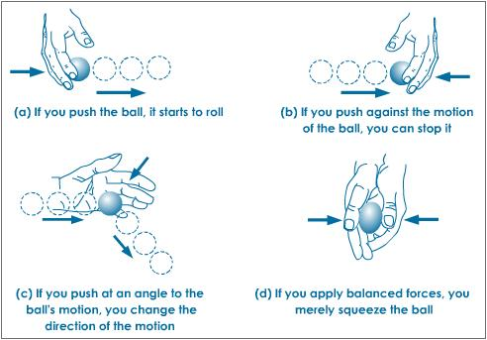
What are the effects of forces?
A Force may cause (start), prevent (stop), or
modify motion (slow, speed or change direction)
A Force may change the shape of an object.

Slide 9
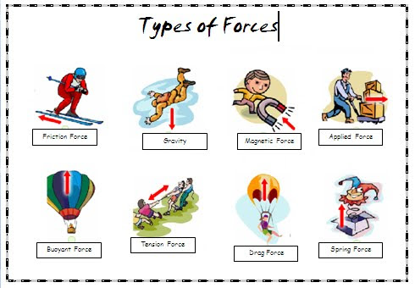

Slide 10
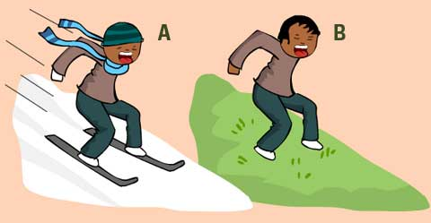
Friction is a force that tries to stop materials gliding past each other. It occurs where two solid objects rub against each other. The amount of friction between two objects depends on how well the surfaces grip each other.
Friction can prevent machinery from moving freely. It also causes any moving parts to heat up. That's why heavy machinery often use lubricants, such as oil, to help keep the parts moving smoothly. To reduce friction, wheels are often mounted on ball bearings or oil is used to make moving surfaces more slippery.
Friction can be quite useful. It allows shoes and tires to grip to the ground. It is also useful in braking systems.

Slide 11

Newton’s 3 Laws

Slide 12
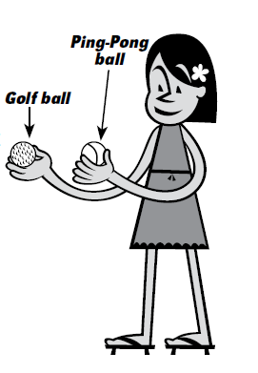
Gravity Challenge
Hold the golf ball and
ping-pong ball at shoulder
height
Drop at the same time
WAIT….FIRST, Predict,
Explain then
Observe and Explain

Slide 13
Quick Quiz
Which hits the ground first in each situation?
(a) A Ping-Pong ball or a golf ball, dropped from shoulder height________________________
(b) A Ping-Pong ball or a golf ball, dropped from 5 m_ _______________________________
(c) A book or a piece of paper, dropped from shoulder height_ _________________________
(d) A feather or a coin, dropped from shoulder height________________________________

Slide 14
Gravity challenge

Slide 15
Indigenous Perspectives

Slide 16

Slinky
When you drop a Slinky, what falls to the ground first: the top, the bottom, or everything all at once?
Let’s PREDICT and EXPLAIN before we carry out the experiment.

Slide 18

Soup Can
Have a race down 2 ramps between the cans of soup (2 different kinds of soup—cream of mushroom and broth).
Try the PEOE sheet with this one!

Slide 19
Ramps
Even a simple experiment using rulers and marble can get students thinking.
What do YOU think the relationship is between the slope of the ramp and the distance or speed the marble travels?
Write a HYPOTHESIS and PREDICTION.
Design a simple experiment and record some data
Graph the data on the white boards
Prepare to share!

Slide 20
What does inquiry look like?

Slide 21
Generating Inquiry Questions
Step One: Find Your Question FOCUS
-Find a group of 3 who want to use the same big idea as you

Slide 22
Step 2: Ask and Share Questions
Ask and list as many questions as possible on the sheet
List questions as they were posed, don’t stop to judge, edit or revise questions!
Flip any statements into questions
DO THIS FOR 8 minutes!

Slide 23
YOU CAN INTERRUPT….
4 minutes in, you might wish to provide a provocation—such as a video or one of the demos; alternately, you can provide the vocabulary list from that section of the curriculum.

Slide 24
Step 3: Flip Closed to Open
Explain to students the difference between closed and open questioning.
Give one minute to identify CLOSED and OPEN questions
Then give them another 4 minutes to flip to open questions

Slide 25
Step 4: Pick your Top 3
Have students pick their top 3 questions to start their investigation—do some background research so they can narrow it to one favourite idea.

Slide 26
DINNER BREAK

Slide 27
Now explore:
Read through the four-pager on your topic area
Explore with those in your grade group, looking at the materials and suggested questions that are set up in the superlab

Slide 28

On The Back of your Name Tag

