Slide 1
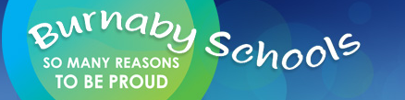
Matter—through an inquiry lens
Donna Morgan
Math/Science Consultant

Slide 2

Acknowledgement
We acknowledge the traditional, unceded territories of the Coast Salish peoples, the Musqueam, Squamish and Tsleil-Waututh Nations on whose land we live, learn and work.
Notes:
10 minute mark for Lilian Dyck segemnt

Slide 3
Reminders
Science Blog
Science and Children
Science Video Contest April 30
May 9

Slide 4
Session Objectives
Develop an overview of MATTER CONCEPTS as they build through the K-7 curriculum
Learn some lab invitations, hands on inquiry and some demonstrations to stimulate thinking.
Develop tools to assess inquiry
Weave Indigenous perspectives into the teaching of these topics
Make cross curricular connections with MATTER topics

Slide 5
Agenda
Acknowledgement
Introductions
Overview of MATTER (30 min)
Assessment of Inquiry using Curricular Competencies (20 minutes)
Hands On Experiment learn 4 different experiments and how they can be used for inquiry (25 minutes)
SUPPER BREAK: 5:00 (30 min)
Hands on—continue for 15 min
Tying it together—finding resources(10 min)
Feedback/Prizes (We will end at 6 today)

Slide 6
OUR BIG IDEAS TODAY
K: Humans interact with matter every day through familiar materials.
Gr 1: Matter is useful because of its properties.
Gr 2: Materials can be changed through physical and chemical processes.
Gr 3: All matter is made of particles.
Gr 4: Matter has mass, takes up space, and can change phase.
Gr 5: Solutions are homogeneous.
Gr 6: Everyday materials are often (heterogenous and homogenous) mixtures.
Gr. 7: Elements consist of one type of atom, and compounds consist of atoms of different elements chemically combined.

Slide 7
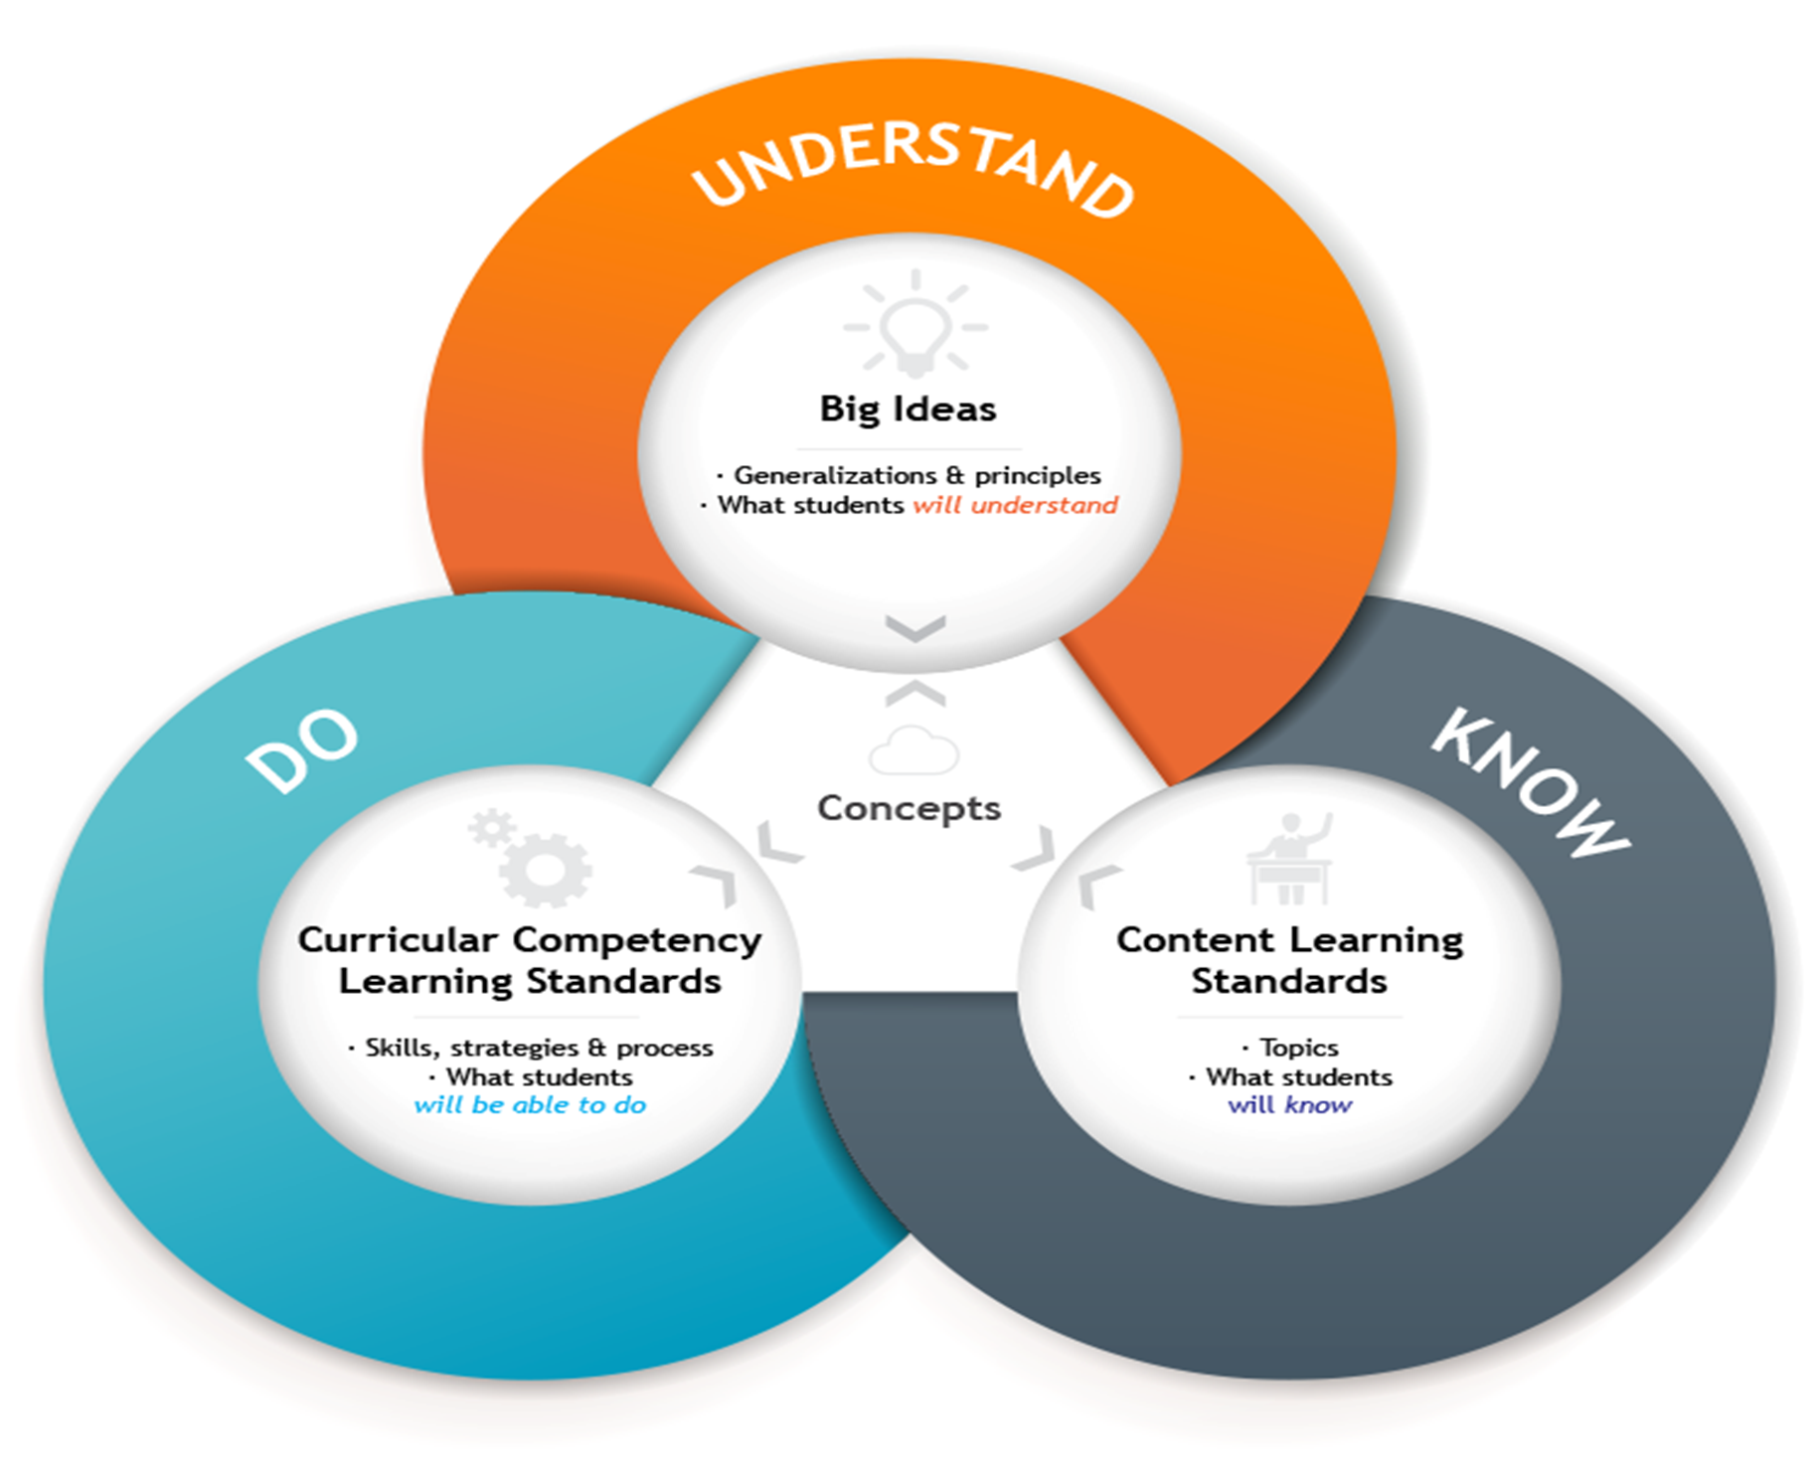

Slide 8
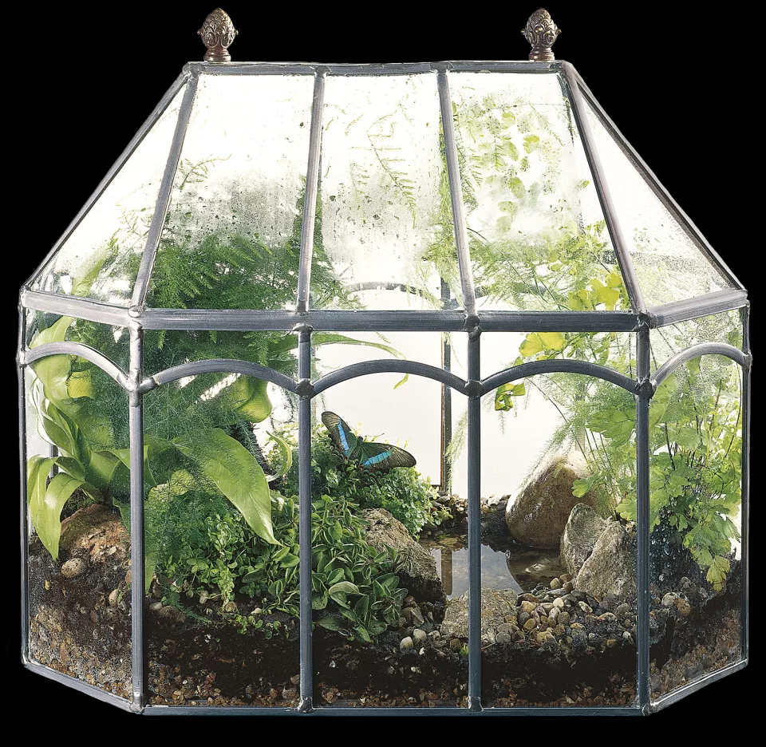
WHAT IS A MATTER?
Matter is another word for the stuff things are made of. Everything around us is made of matter, from the air we breathe to the water we drink—even our own bodies. ... All matter is made up of tiny particles called atoms. Matter takes on different forms depending on how the atoms are arranged

Slide 9
Physical properties
Physical properties are qualities that can be measured or observed without changing the chemical nature of the substance. Some examples of physical properties are:
• color • texture
• lustre • flexibility
• density (intensive)
• volume (extensive)
• mass (extensive)
• boiling point (intensive)
• melting point (intensive)
Notes:
lustre (shiny, dull, fluorescent)
flexibility (brittle, malleable, ductile, flexible—bendable, stretchable, breaks easily apart,)

Slide 10
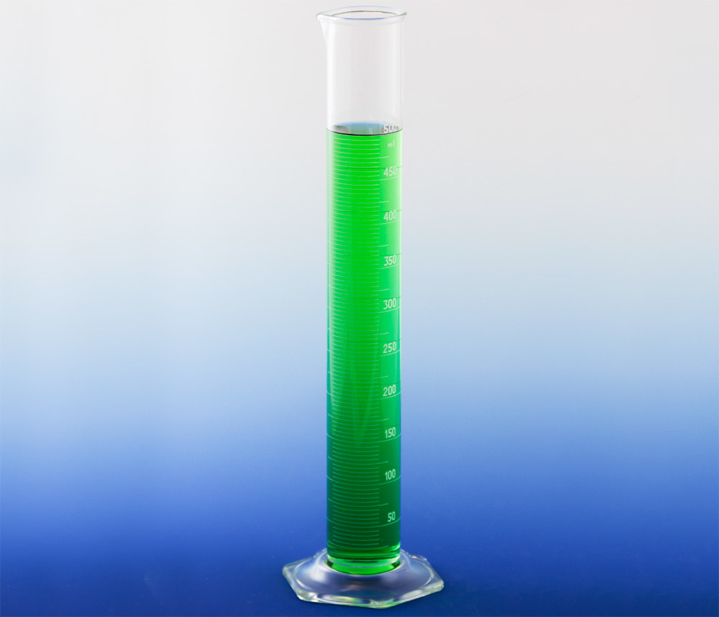
Density Demo

Slide 11
Chemical Properties
Chemical properties are characteristics that are determined by how a substance interacts with other materials:
Flammability: reaction with oxygen to burn
Stability vs Reactivity: how readily does it react?
Acid/Base interactions
Toxicity: Is it poisonous?

Slide 12
Classifying matter
Take your envelope of words and see if you can classify them

Slide 13
Classifying matter
Take your envelope of words and see if you can classify them
How about if I give you these words: compound; element; mixture; pure substance; homogenous; heterogenous

Slide 14
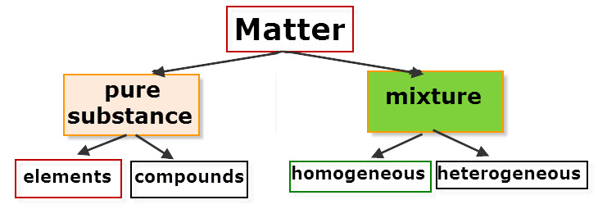
How about if I give you this schema?

Slide 15
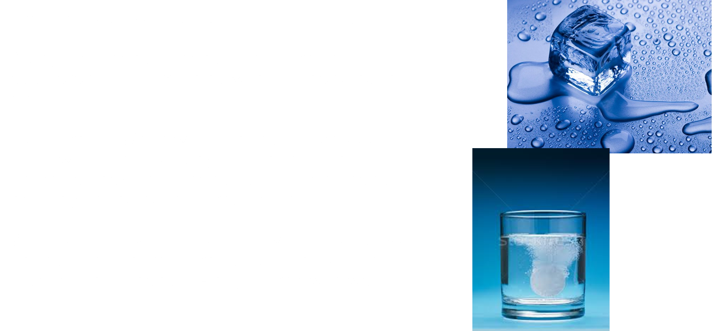
What is a physical change?

Slide 16
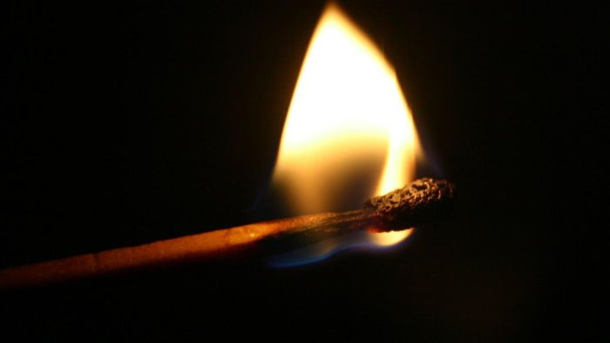
What is a chemical change?
A chemical reaction happens when one or more substances change into entirely new substances with different
properties.
When we burn a match, a chemical reaction occurs. Heat is made, smoke (gas) is made, and the resulting match is very different. It is also hard to UNDO.

Slide 17
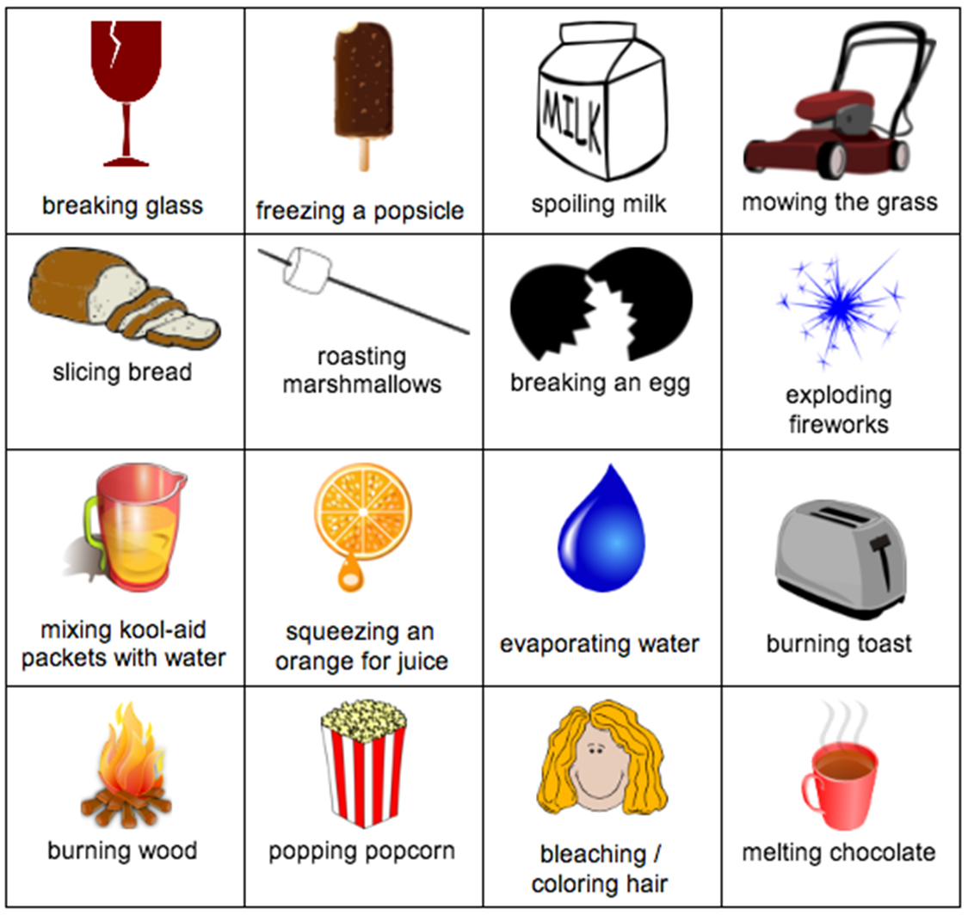

Slide 18
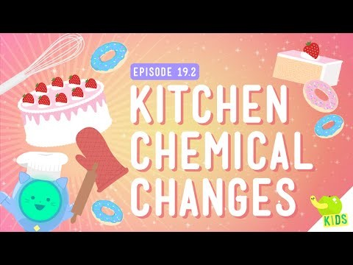

Slide 19
Demo time
Can you identify chemical and physical changes?

Slide 20
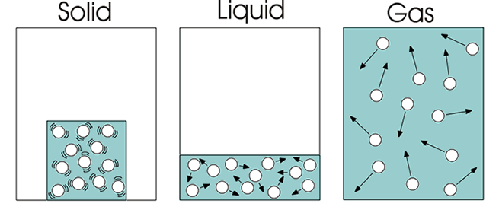
States of Matter

Slide 21
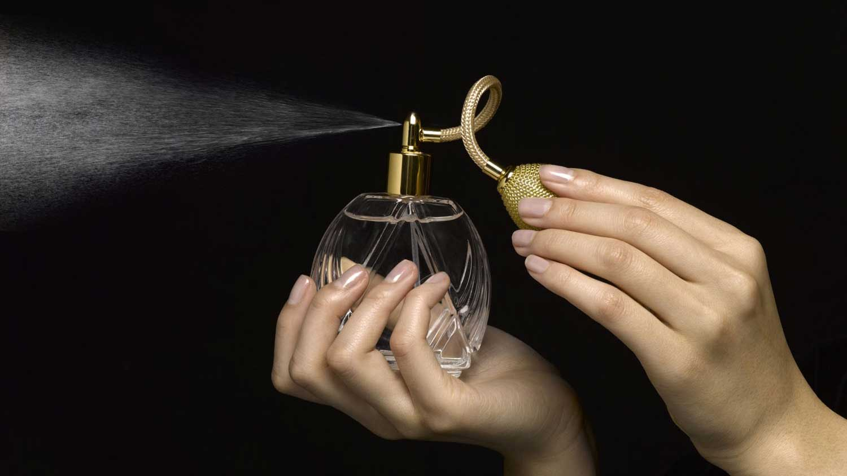
Randomness: The toughest concept in Science

Slide 22
Mixtures
Solutions are HOMOGENEOUS (same through-out, mixed at molecular level)
Mechanical Mixtures, Suspensions, Emulsions and Colloids are HETEROGENEOUS (varied)
A heterogeneous mixture is a mixture in which the composition is not uniform throughout the mixture.
A phase is a separate layer in a heterogeneous mixture.

Slide 23
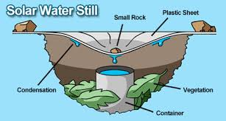
Separation techniques
We can use various ways to separate solutions and heterogeneous mixtures.
Oolichan Grease

Slide 24
Designing Experiments
https://www.facebook.com/MythBusters/videos/10155560170523224/?t=60

Slide 25
Assessing Inquiry
Types of Evidence We can Collect
Formal and informal observations
Discussions, learning conversations, questioning, conferences
Tasks done in groups
Demonstrations, performances
Projects, portfolios
Peer and self-assessments
Self-reflections

Slide 26
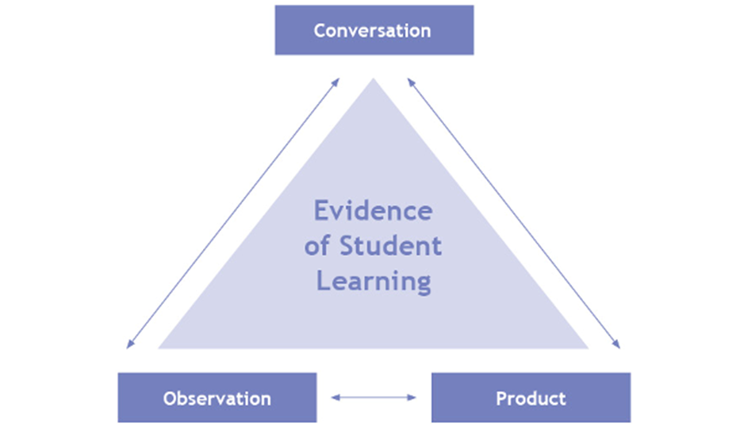

Slide 27
Key Steps in Planning Assessment
Plan the assessment at the same time as you plan the unit
Have clear criteria—and where possible, co-construct the criteria with students
Plan assessment to be on-going, have multiple points where students get feedback, and vary WHO gives the feedback (teacher, peer, self, audience)

Slide 28
Now explore:
Read through the four-pager on your topic area
Explore the four “LOW CEILING/HIGH FLOOR” activities in the Superlab.

Slide 29
DINNER BREAK

Slide 30

On The Back of your Name Tag

