Slide 1
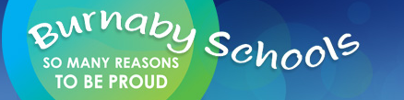
Organisms, Diversity and Evolution—through an inquiry lens
Donna Morgan
Math/Science Consultant

Slide 2
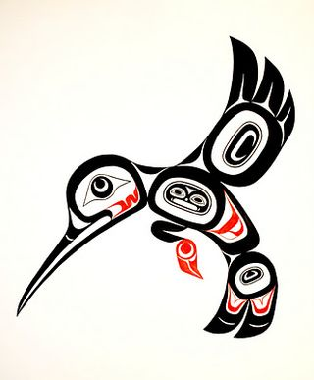
Acknowledgement
We acknowledge the traditional, unceded territories of the Coast Salish peoples, the Musqueam, Squamish and Tsleil-Waututh peoples on whose land we live, learn and work.

Slide 3
Session Objectives
Develop an overview of BIOLOGY CONCEPTS as they build through the K-7 curriculum
Learn the INQUIRY CYCLE and how it might be applied to these big ideas
Understand how we can use PLACE to weave Indigenous perspectives into the teaching of these topics
Make cross curricular connections
See some activities to stimulate inquiries about organisms
Integrate the curricular competencies and learning standards into a unit on these big ideas

Slide 4
Agenda
Acknowledgement
Introductions
Overview of Biology (25 min)
7 E Inquiry Cycle (10 min)
Grade Level Groups—curriculum overview (4 pagers)-Read and Discuss (15 min)
Engage with resources (20 min)
SUPPER BREAK: 5:15 (30 min)
Tying it together—inquiry ideas/planning framework (30 min)
Feedback

Slide 5
OUR BIG IDEAS TODAY
K: Plants and animals have observable features.
Gr 1: Living things have features and behaviours that help them survive in their environment.
Gr 2: Living things have life cycles adapted to their environment.
Gr 3: Living things are diverse, can be grouped, and interact in their ecosystems.
Gr 4: Organisms interact in their biomes.
Gr 7: Evolution by natural selection provides an explanation for the diversity and survival of living things

Slide 6
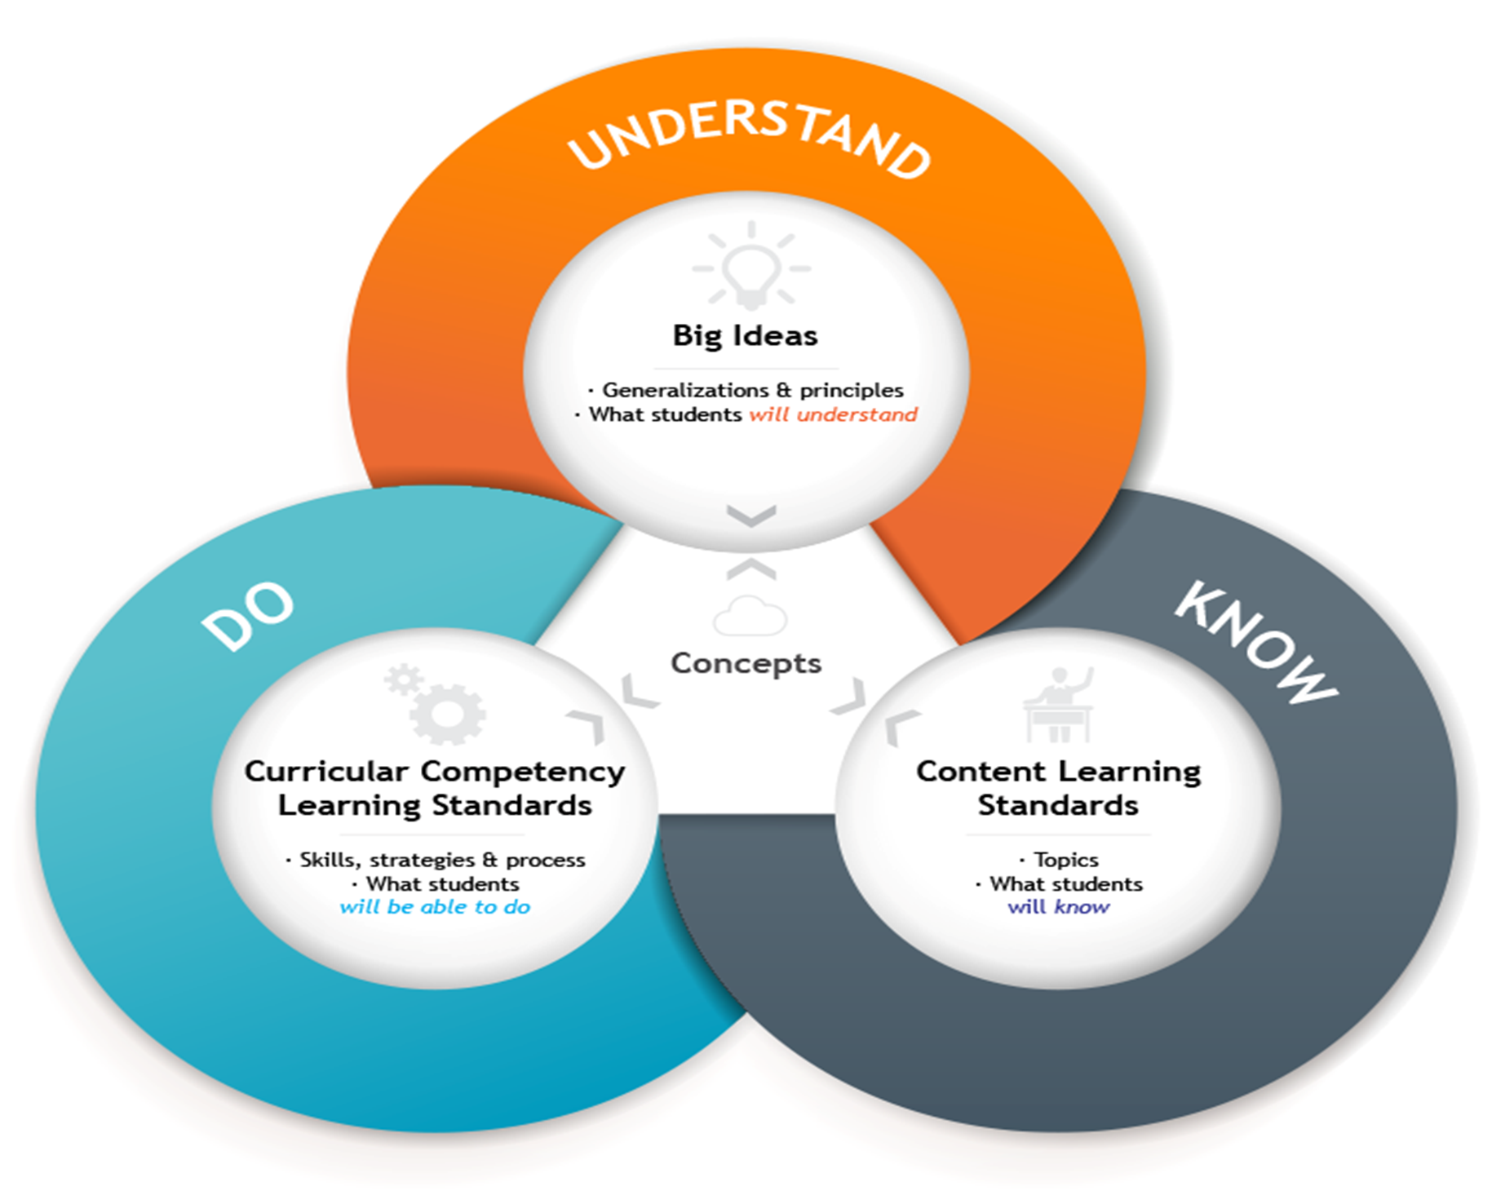

Slide 7
What are the characteristics of living things?

Slide 8
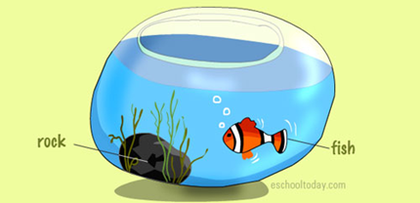
Characteristics of Living Things
Energy (nutrition)
Cells
DNA/genetic material
Reproduction
Growth & Development
Response
Evolve

Slide 9
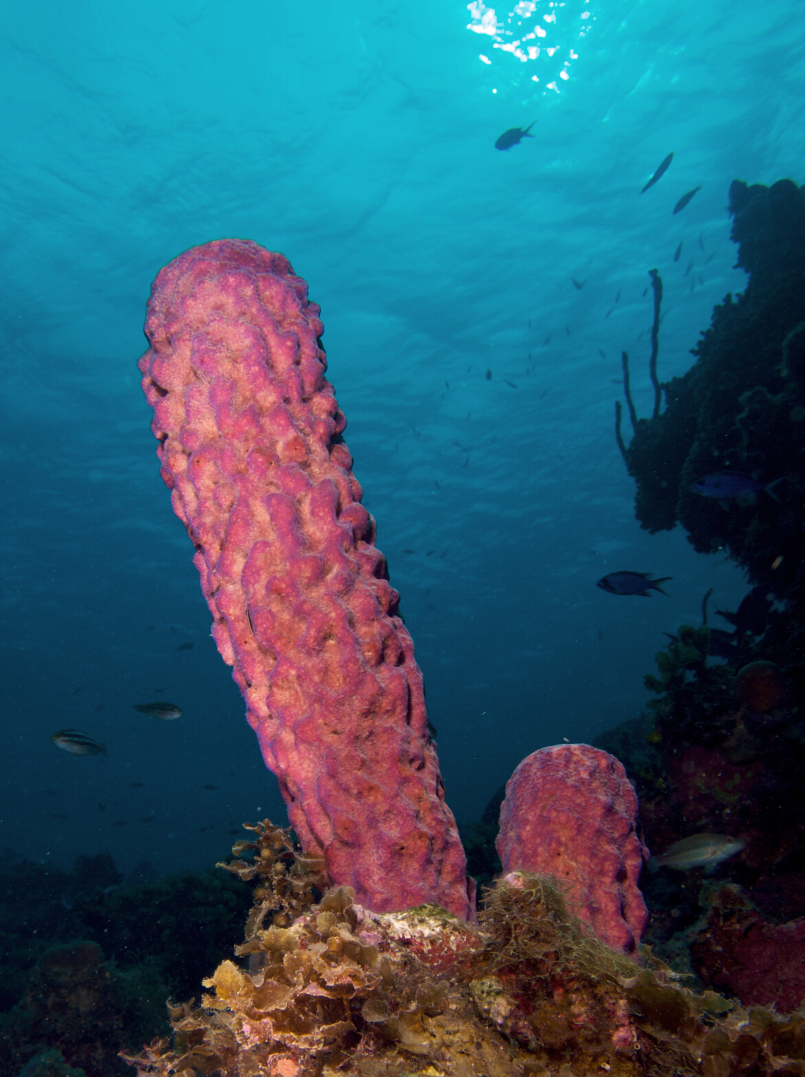
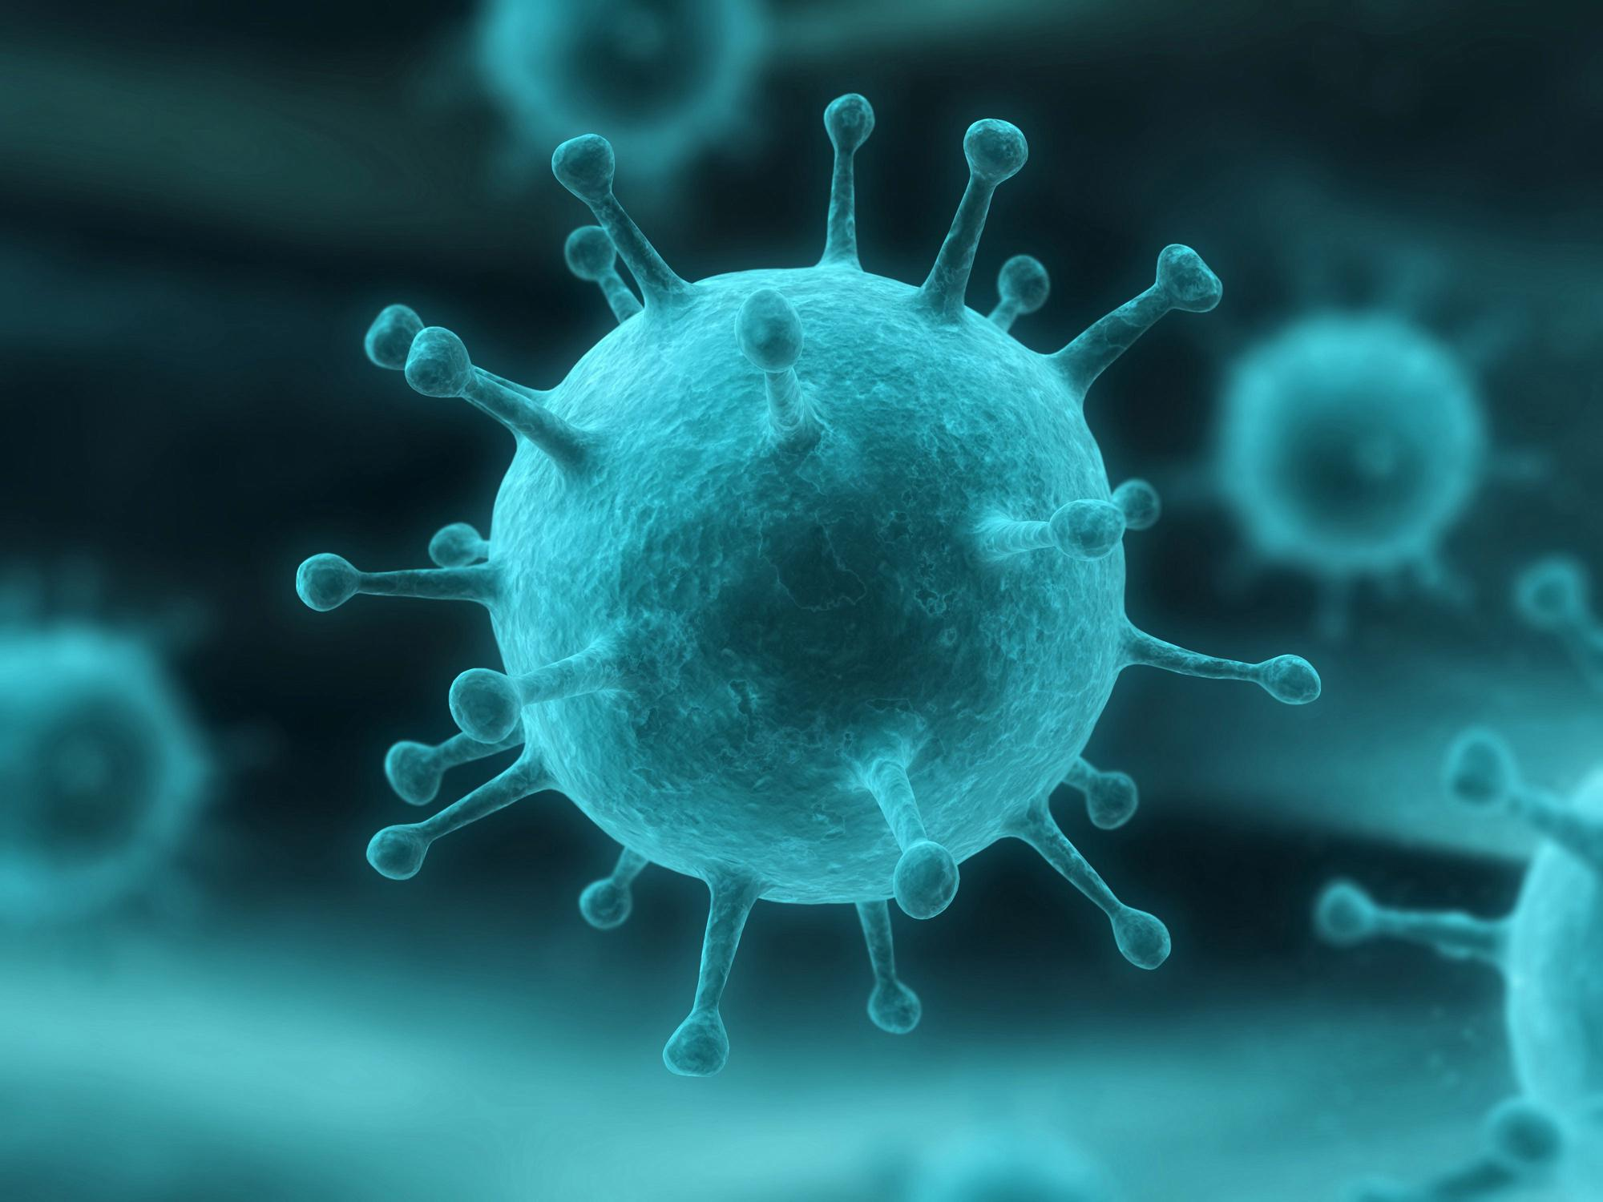
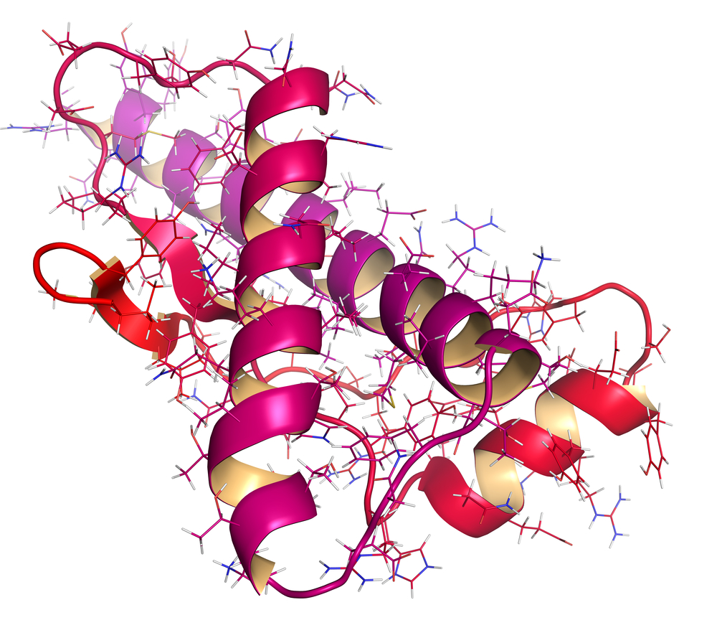
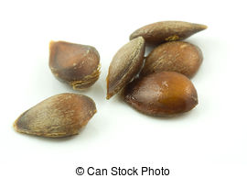
Is this living?

Slide 10
Biology has two great concepts: UNITY
As diverse as life is, it also displays remarkable unity. There are genetic similarities within the DNA of organisms as different as bacteria and animals. Unity is also evident in many features of cell structure.
Common ancestry means that all living things past, present, and future share an ancestor, and all descended from that one individual. Scientists believe that the most recent common ancestor to all existing life forms lived about 3.9 billion years ago. This ancestor gave rise to the three domains of life—Eukarya, Bacteria, and Archaea—and all the organisms that comprise those domains.

Slide 11
And DIVERSITY
So far, biologists have identified and named about 1.8 million species. This diversity of life is known to include at least 6,300 species of prokaryotes (bacteria), 100 thousand fungi, 290 thousand plants, 52 thousand vertebrates (animals with backbones), and 1 million insects (more than half of all known forms of life). Identifying thousands of additional species each year, estimates of the total number of species range from about 10 million to over 100 million. Regardless of the actual number, the enormous variety of life gives biology a very broad scope. This vast diversity can become a challenge to make sense of.

Slide 12
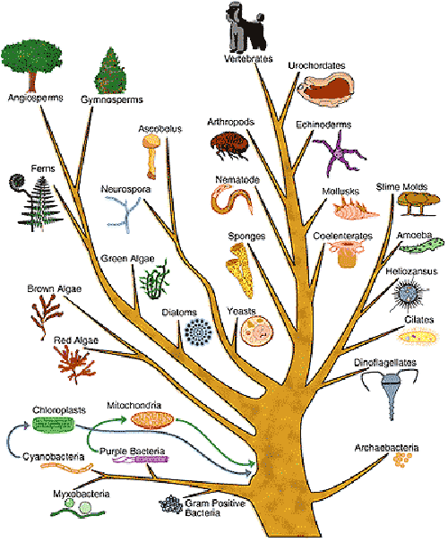

Slide 13
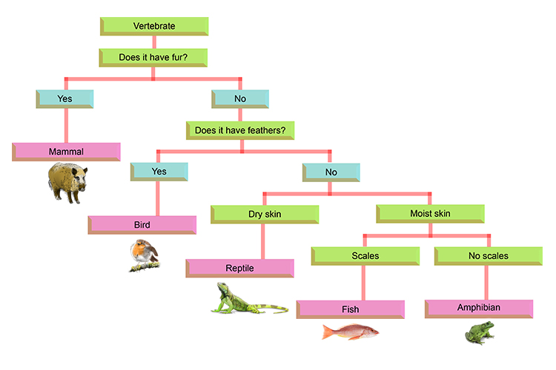
Make a dichotomous key….
In groups of 6-8, make a key based on the Salish Sea animal card you have been given…

Slide 14
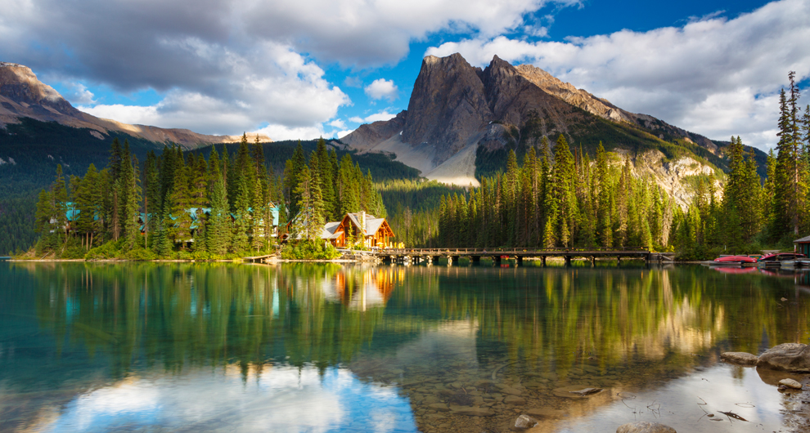
PLACE is important. We live in a wonderful province, in a rich biome (temperate coniferous rainforest) with great diversity.
The range of habitats in British Columbia includes forests, grasslands, meadows, wetlands, rivers, and intertidal and sub-tidal zones. According to BC Environment figures, these habitats support:
143 species of mammals,
454 bird species
20 amphibian species,
19 reptile species
450 fish species

Slide 15
Here are some statistics describing the richness of BC’s nature (source BC Environment):
Three-quarters of Canada’s mammal species are found in British Columbia; 24 of those species are exclusive to our province.
Over 250 bird species breed in the province, 162 of those (55%) breed nowhere else in Canada.
Invertebrate species probably number between 50,000 and 70,000, including 35,000 species of insects. B.C. has some of the most beautiful and most rare species of butterfly in Canada.
British Columbia has an estimated 2790 native vascular plants species, (nearly 27% are considered species at risk).
Approximately 1000 bryophytes (mosses and liverworts)

Slide 16
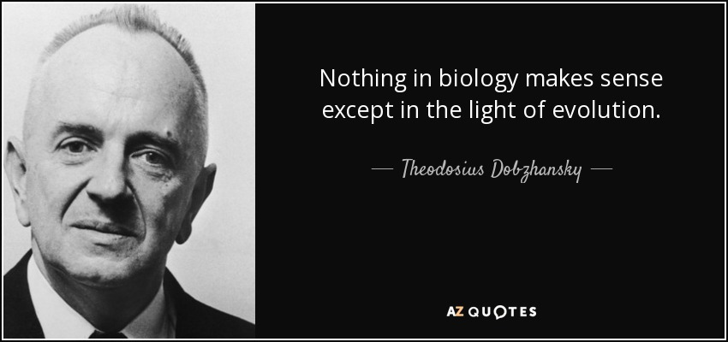

Slide 17

A brief summary….

Slide 18
Barbellus….

Slide 19
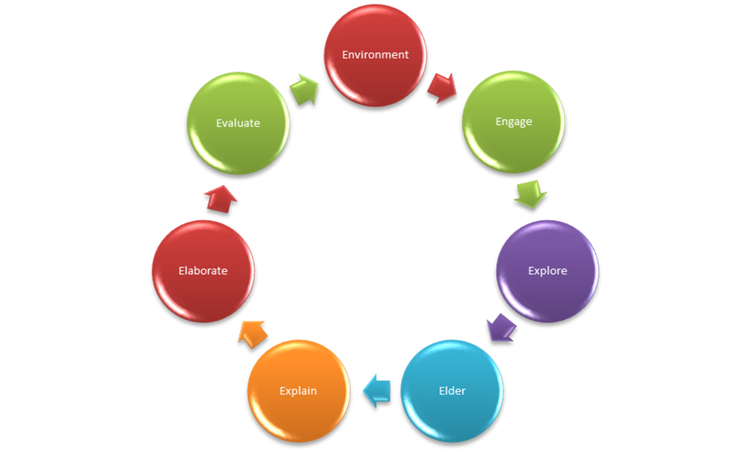
Using the ENVIRONMENT as one of the 7 E’s…

Slide 20
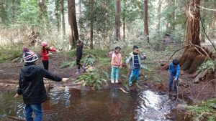
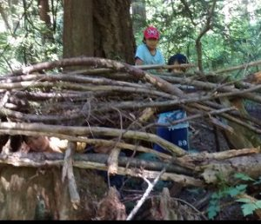
Use the environment as your starting point….
http://blogs.sd41.bc.ca/placebasedlearning/

Slide 21
Now explore:
Read through the four-pager on your topic area
Explore with those in your grade group, looking at the materials and suggested questions that are set up in the superlab
Complete (together) the sheet on suggested inquiries

Slide 22
Make some plans
DINNER BREAK
Discussion and support—what resources do you want/need?
At 6:05—let’s come together to share our

Slide 23
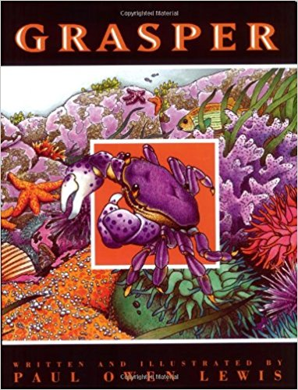
To finish up…

