Slide 1
A Container Challenge
This powerpoint is available for teacher use on-line at: http://blogs.sd41.bc.ca/science/new-curriculum-support/dlrc/thermal-energy/

Slide 2

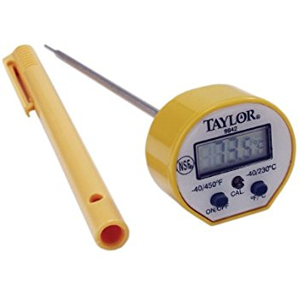

GOALS
I can explain how heat energy moves by
Radiation, conduction and convection
I can design an insulated container using natural materials
I can record information on a table
I can read a digital thermometer
I can make predictions
I can ask questions

Slide 3
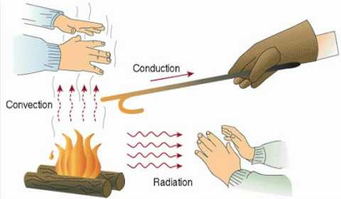
How does heat move?

Slide 4
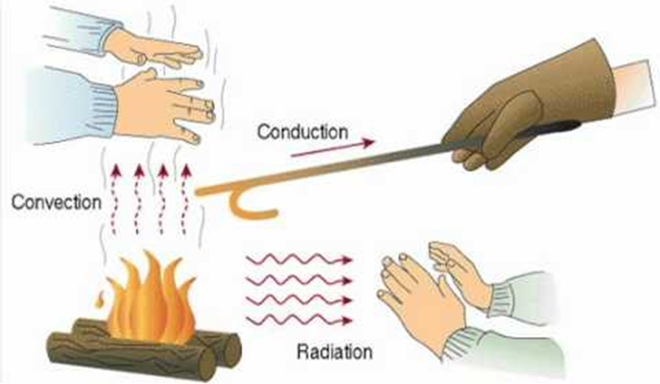
How does heat move?

Slide 5
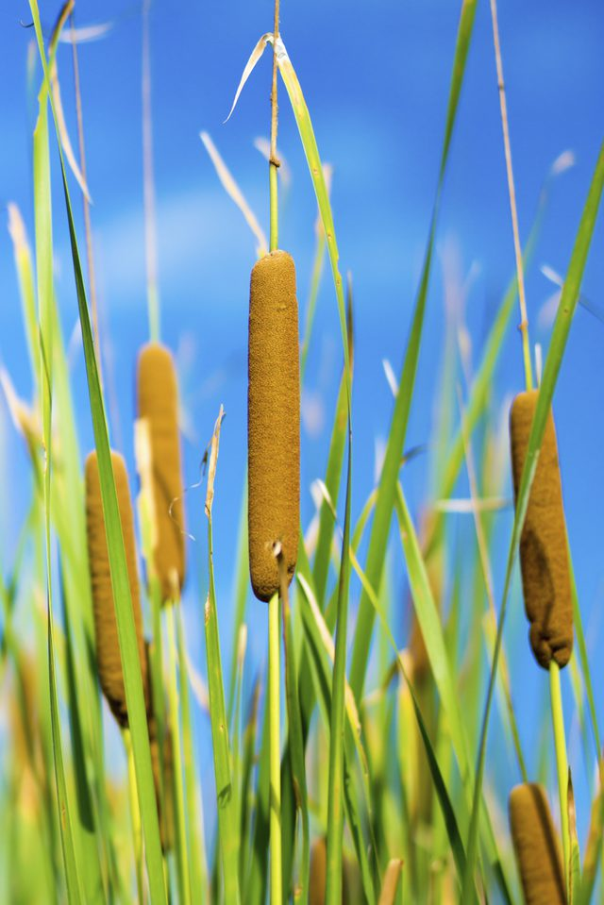
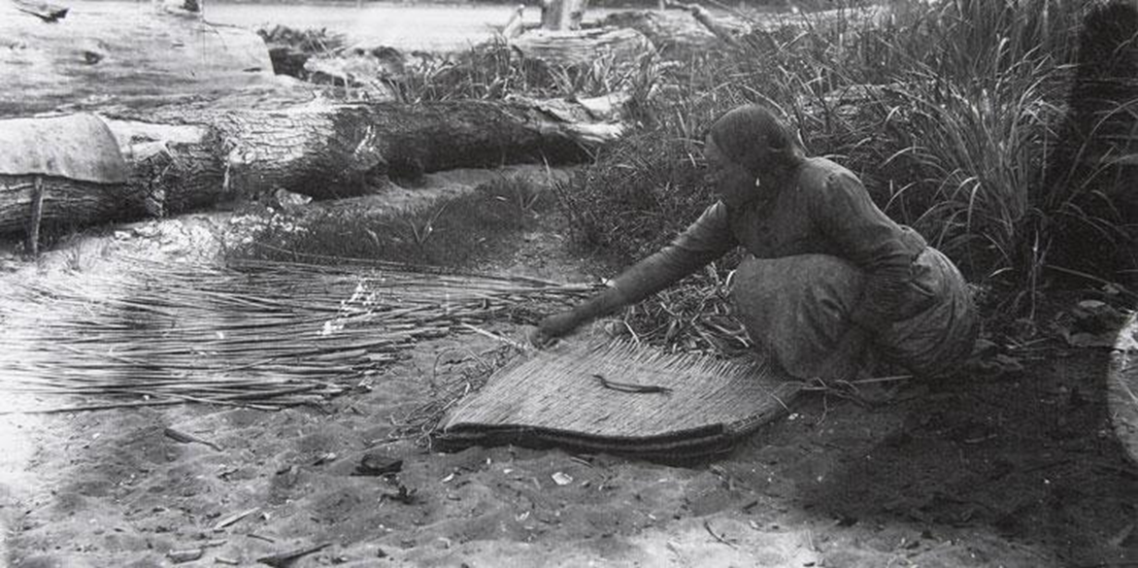
Some natural insulators…

Slide 6
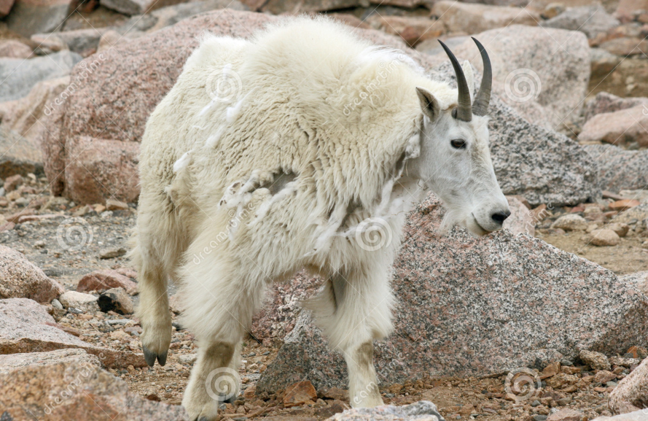
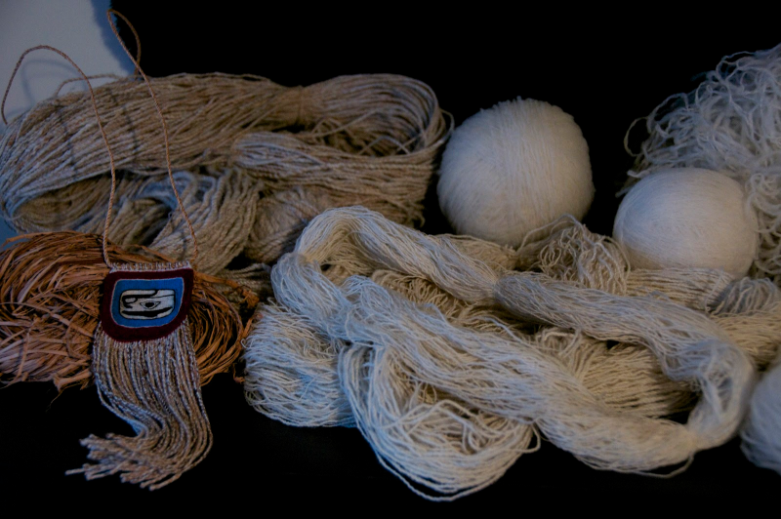
Some natural insulators…

Slide 7
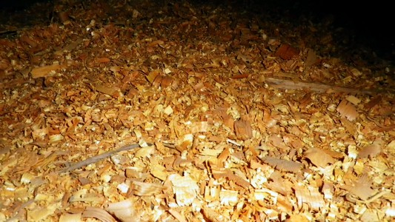
Some natural insulators…

Slide 8
A container challenge
I’m going to give you a container, a thermometer, a piece of aluminum foil, and you will choose one of 3 natural materials.
Work in groups of 3 to design your container to keep the most thermal energy IN.
When you are ready, I will put hot water in your container, and you can measure the temperature for 10 minutes and record it. I will measure the same amount of water in a container without an outer layer. (This is called the “CONTROL” container)

Slide 9
Which material?
Which material worked best?
How did your container stop conduction, convection and radiation?
Why did we need “the control” container?
How would you revise your design?

