Slide 1
Radiation

Slide 2
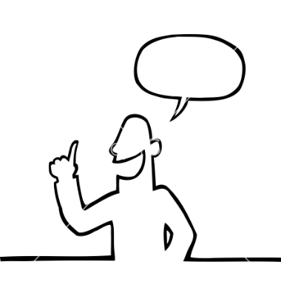
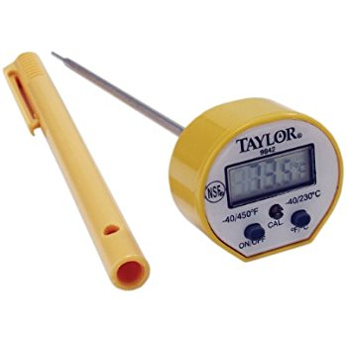

GOALS
I can explain how heat energy moves by
radiation
I can explain which colours absorb and
which colours reflect heat
I can record information on a table
I can read a digital thermometer
I can make predictions
I can ask questions

Slide 3
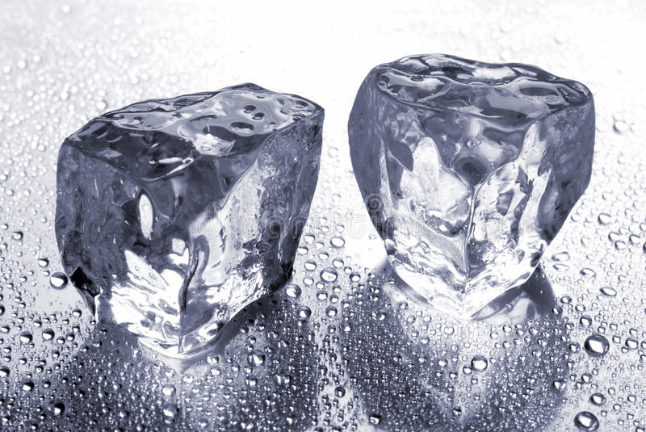
Predict, Observe, Explain
One ice cube is in a black dish, one is in a white dish.
Which one will melt faster?
Write your name on a sticky note and vote:
B, W or =

Slide 4
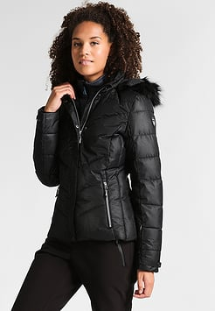
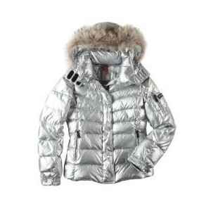
Which jacket?
Thinking question: Which snowboard/ski jacket will keep you warmer?

Slide 5
Where does the world’s heat come from?

Slide 6
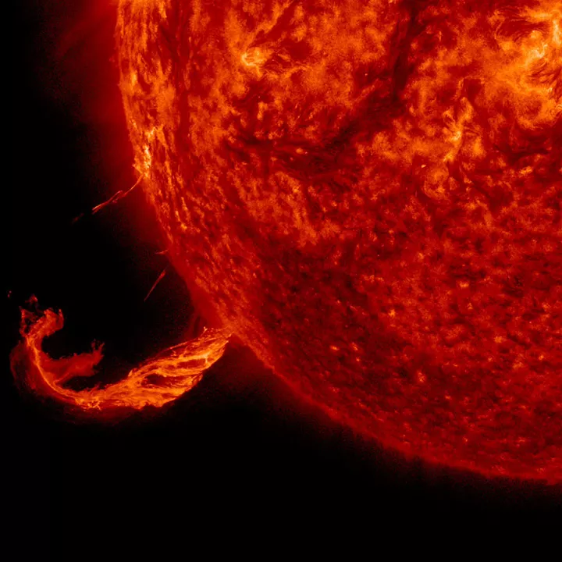
Where does the world’s heat come from?

Slide 7
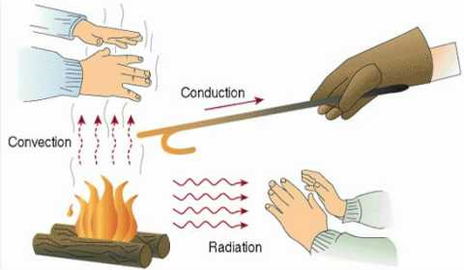
How does heat from the sun get to earth?

Slide 8
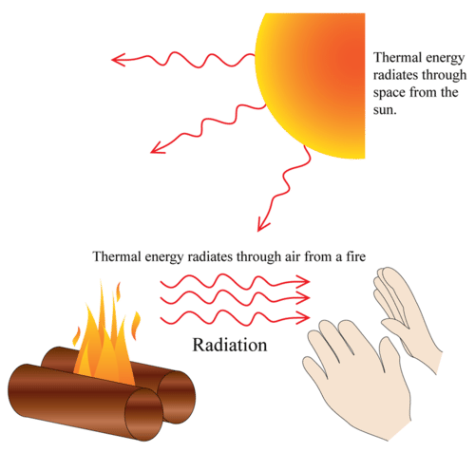
The sun’s energy comes to us through radiation
Radiation travels in waves
It doesn’t require any matter (no solid, liquid or gas)

Slide 9
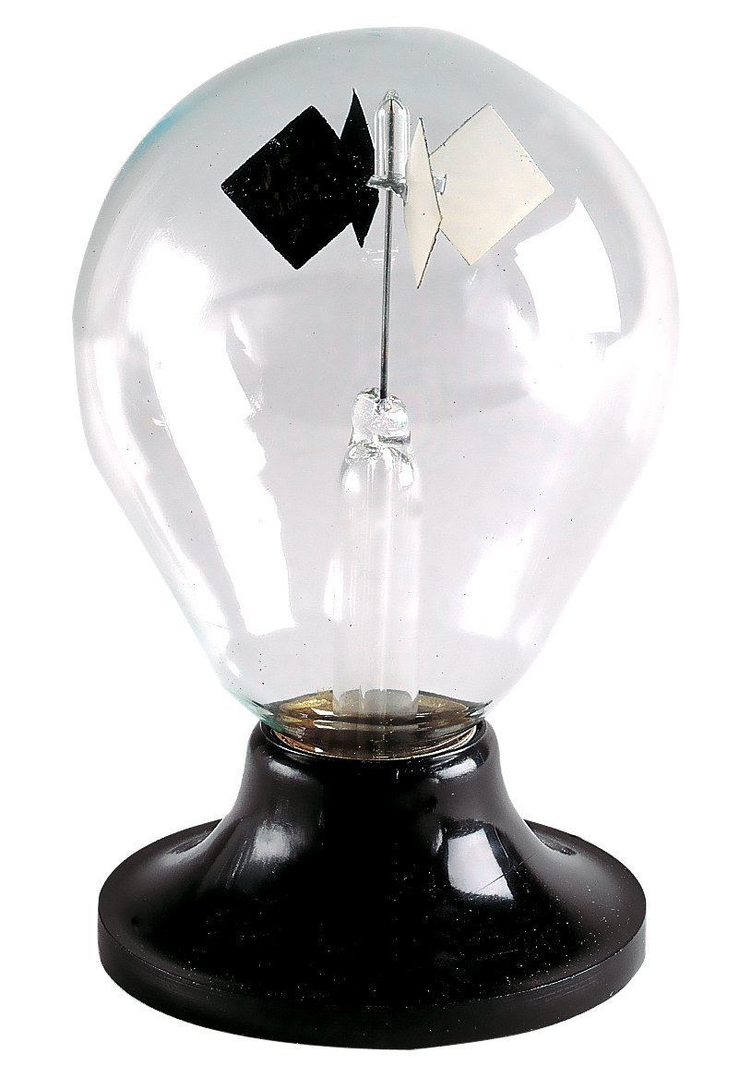
This is a radiometer

Slide 10
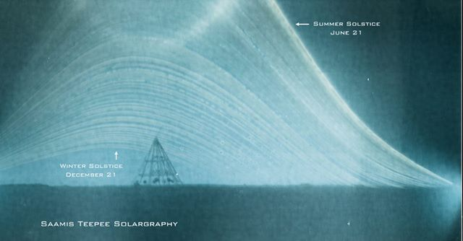

Slide 11
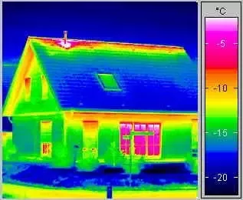
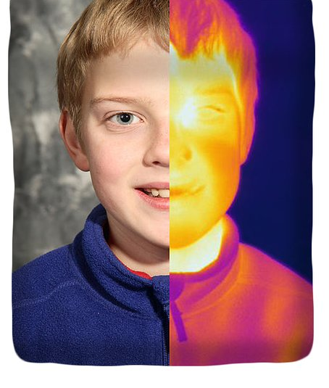
Thermographs measure heat

Slide 12
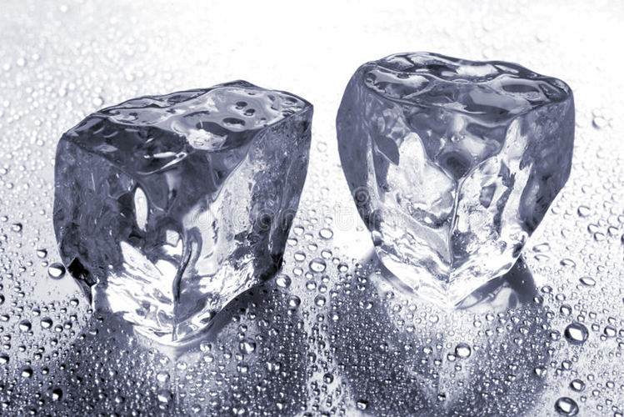
Let’s check out that ice…

Slide 13
A container challenge
I’m going to give you a container, a thermometer, a piece of aluminum foil, and a sheet of black paper.
Work in groups of 3 to to wrap your container to keep the most radiation IN.
When you are ready, I will put hot water in your container, and you can measure the temperature for 10 minutes and record it.

Slide 14
Which jacket?
Thinking question: Which snowboard/ski jacket will keep you warmer?

