Slide 1
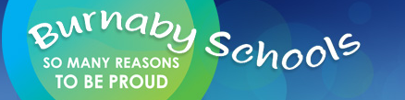
SPACE—through an inquiry lens
Donna Morgan
Math/Science Consultant

Slide 2
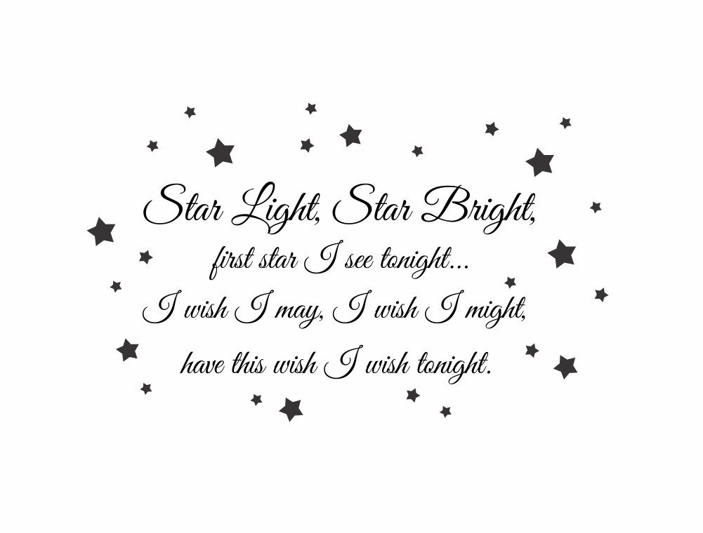
Soft Start
Take a gallery walk around the poems…how might you use these in teaching astronomy?

Slide 3
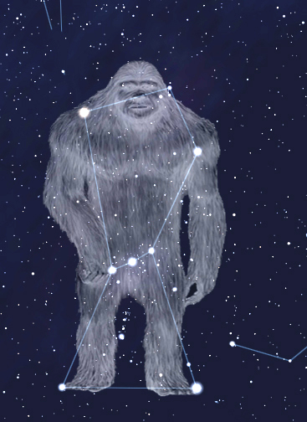
Agenda
Poems
Acknowledgement
Introductions
Intro to Space(30 min)
Assessment of Inquiry using Curricular Competencies (15 minutes)
SUPPER BREAK: 5:00 (30 min)
Hands On Experiments learn different experiments and how they can be used for inquiry (25 minutes)
Tying it together—finding resources(10 min)
Feedback/Prizes

Slide 4

This is the moon of the turning white season (frost). This moon brings the first frost. The leaves lose their colours and turn pale. Deer hunting is the activity during this moon. The earth is cooling down and the people turn their efforts to hunting.
PEKELANEW - The Moon That Turns the Leaves White (October)
We acknowledge the traditional, unceded territories of the Coast Salish peoples, the Musqueam, Squamish and Tsleil-Waututh Nations on whose land we live, learn and work.
Image and words from: http://www.racerocks.com/racerock/firstnations/13moons/moons/pekelanew.html
Notes:
10 minute mark for Lilian Dyck segemnt

Slide 5
Session Objectives
Develop an overview of SPACE SCIENCE CONCEPTS as they build through the K-7 curriculum
Learn some lab invitations, hands on inquiry and some demonstrations to stimulate thinking.
Develop tools to assess inquiry
Weave Indigenous perspectives into the teaching of these topics
Make cross curricular connections with SPACE SCIENCE topics

Slide 6
OUR BIG IDEAS TODAY
K: Daily and seasonal changes affect all living things.
Gr 1: Observable patterns and cycles occur in the local sky and landscape.
Gr 4: The motions of Earth and the moon cause observable patterns that affect living and non-living systems.
Gr 6: The solar system is part of the Milky Way, which is one of billions of galaxies.
Through all: Local First Peoples perspectives

Slide 7
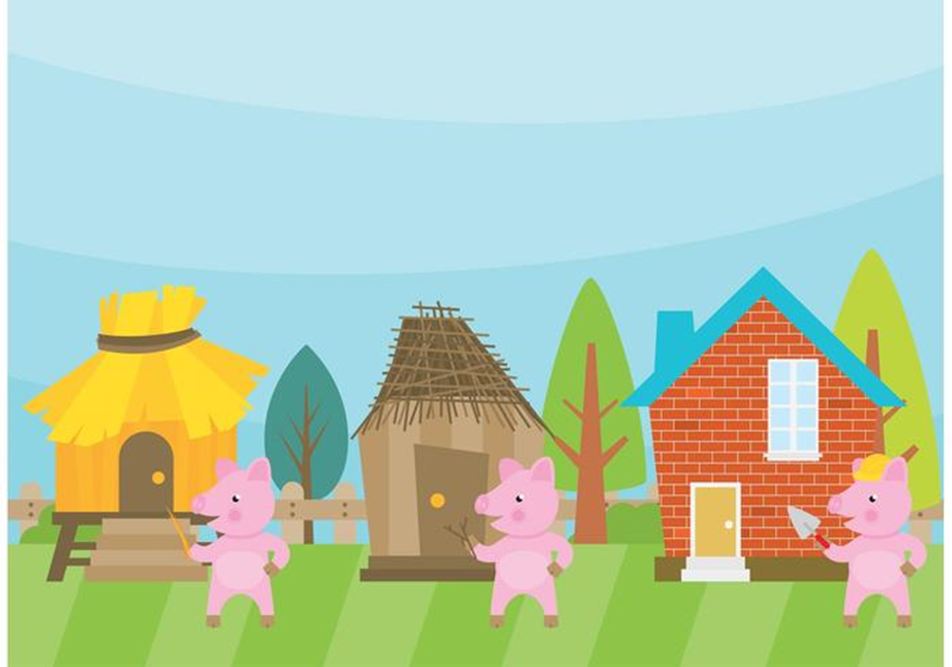
Building student conceptions

Slide 8
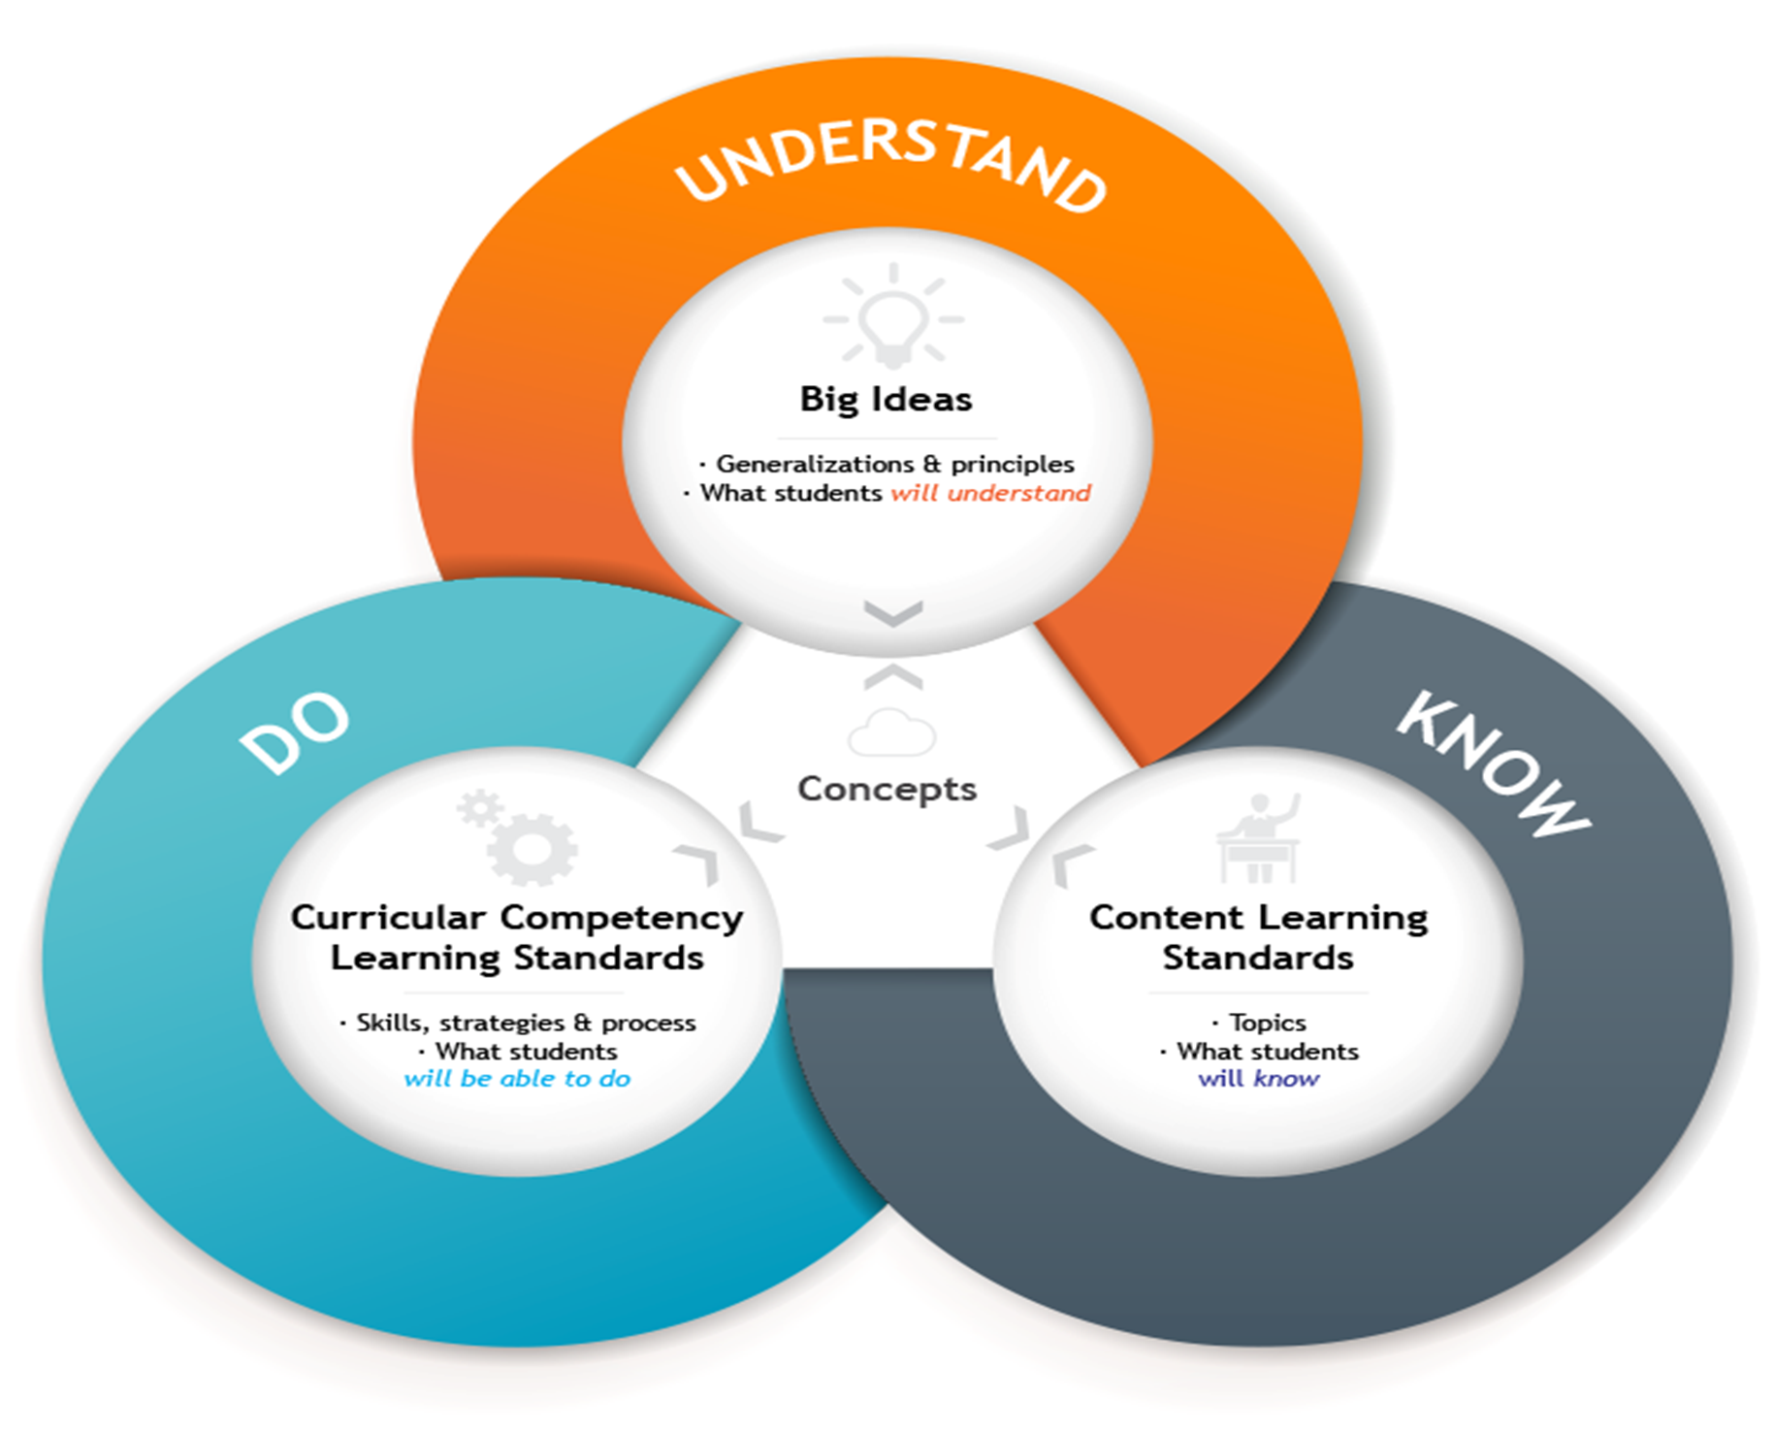

Slide 9
Why do we have summer and fall?
Turn and talk to your neighbour about it.

Slide 10

Do you understand better than Harvard grads?

Slide 11
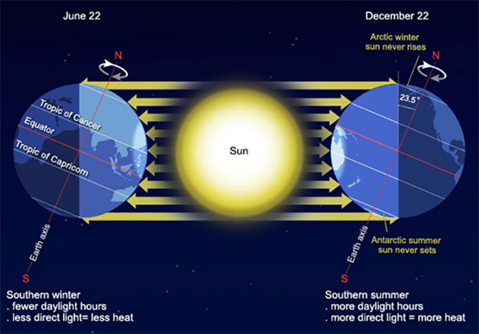

Slide 12
QUIZ
1. E
2. B
3. B
4. A
5. E

Slide 13
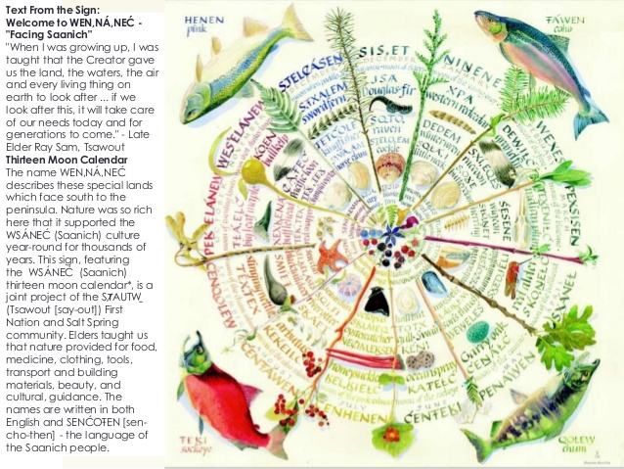
Connect seasons to Indigenous perspectives
Image from: 13 Moons of the WSANEC: http://www.racerocks.com/racerock/firstnations/13moons/13moons.htm

Slide 14
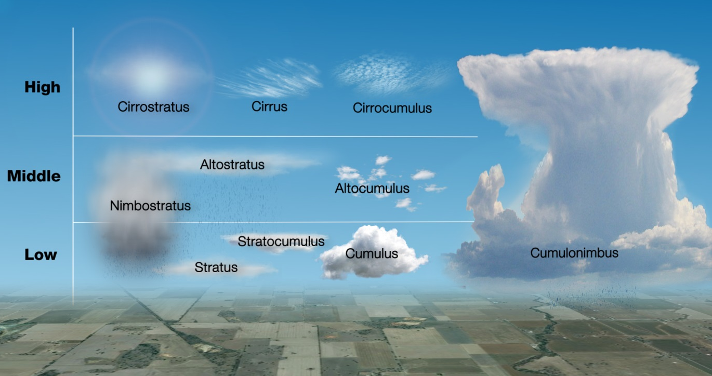
Talk about the clouds—add predictions—which makes rain?

Slide 15
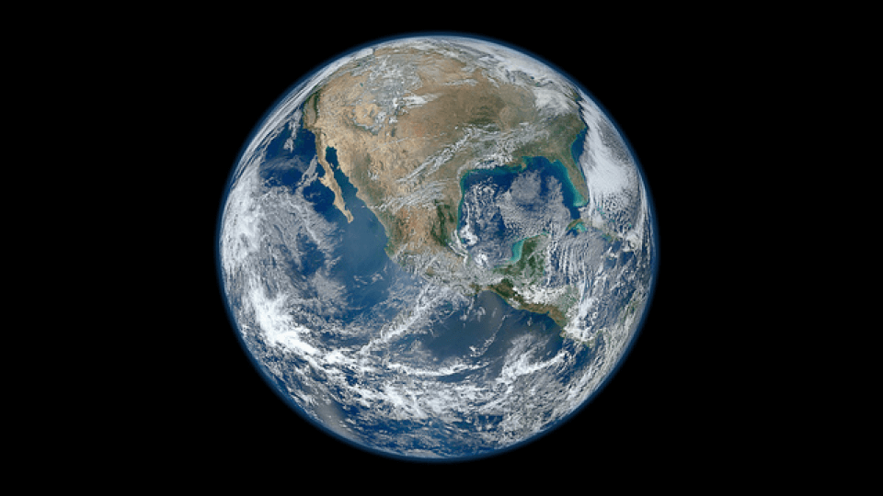
Grade 4—You have ONE job!

Slide 16
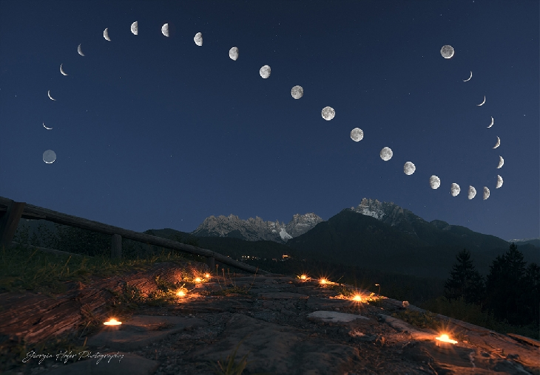
The moon over one month
How can you explain this?
Notes:
Discuss, pass moon viewer around

Slide 17
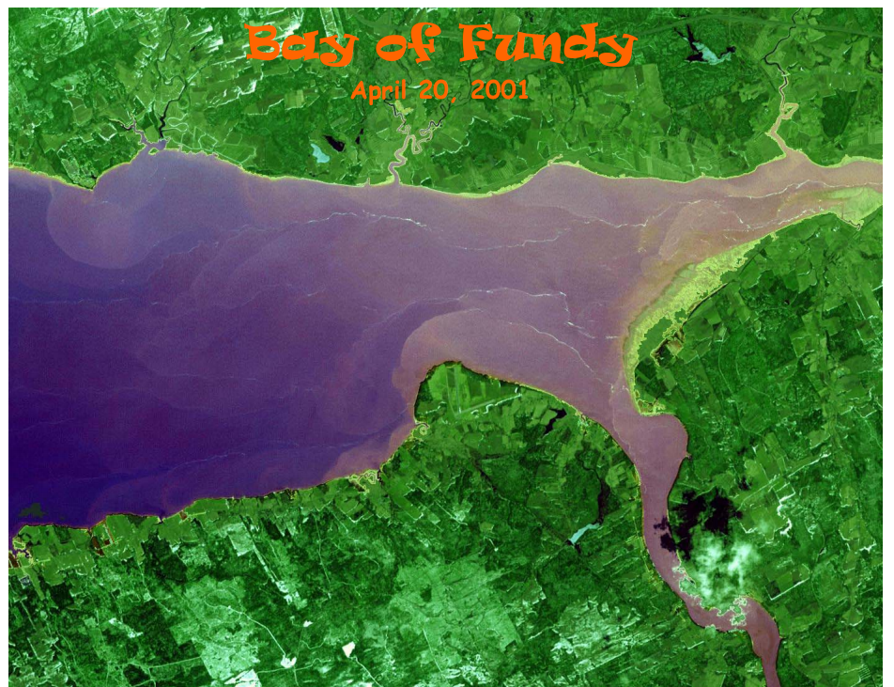
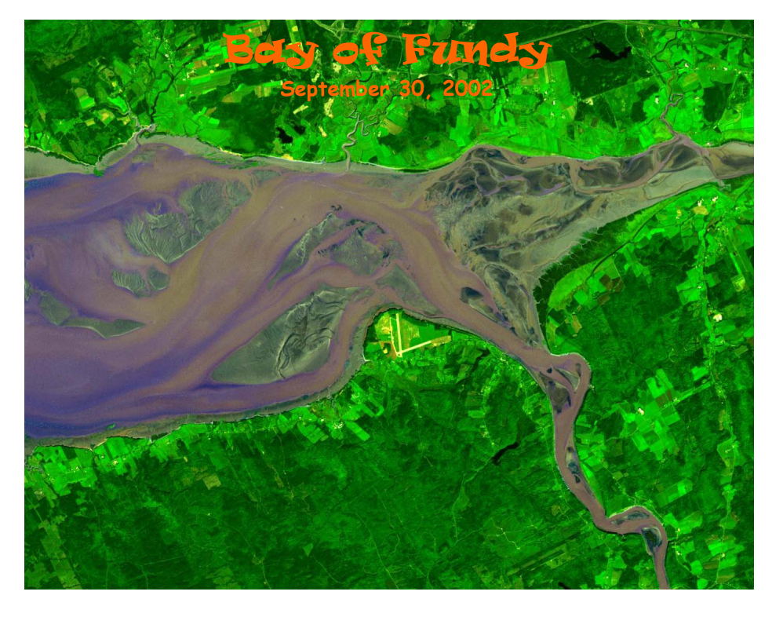

Slide 18
Bay of Fundy Tides

Slide 19

Let’s do a dance https://www.lpi.usra.edu/education/explore/marvelMoon/activities/whatIf/dance/

Slide 20
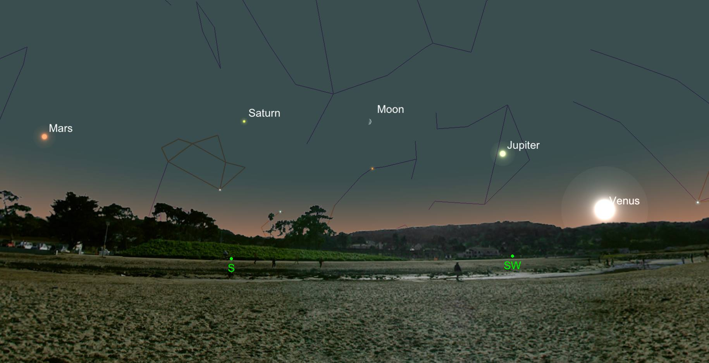
Grade 6—The Solar System and Beyond

Slide 21
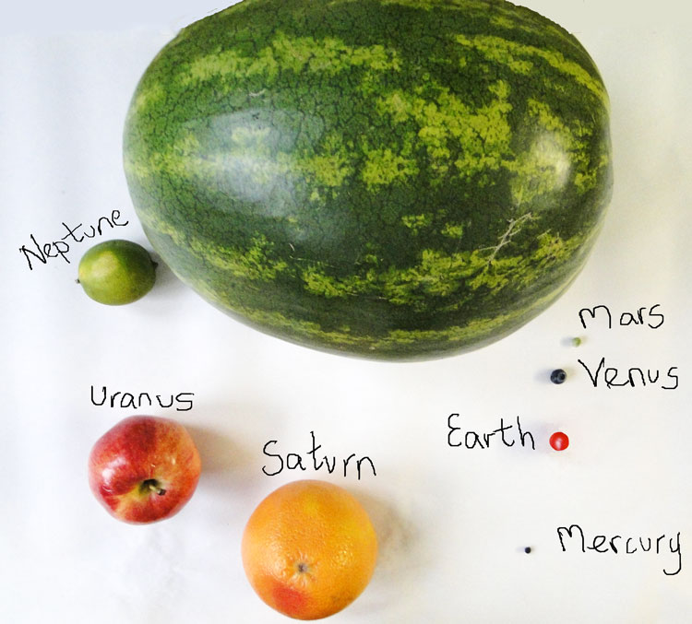
Farmer’s Market Solar System
How shall we arrange these fruits/veg into a solar system?
What can we learn from models?
How can models assist us in inquiry?

Slide 22
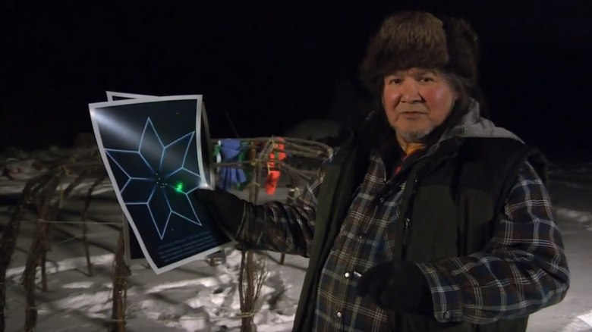
Constellations… https://www.facebook.com/cbcunreserved/videos/wilfred-buck-and-cree-constellations/1094638160560376/

Slide 23
Understand the scale…
Notes:
Go to 1:35

Slide 24
Assessing Inquiry
Types of Evidence We can Collect
Formal and informal observations
Discussions, learning conversations, questioning, conferences
Tasks done in groups
Demonstrations, performances
Projects, portfolios
Peer and self-assessments
Self-reflections

Slide 25
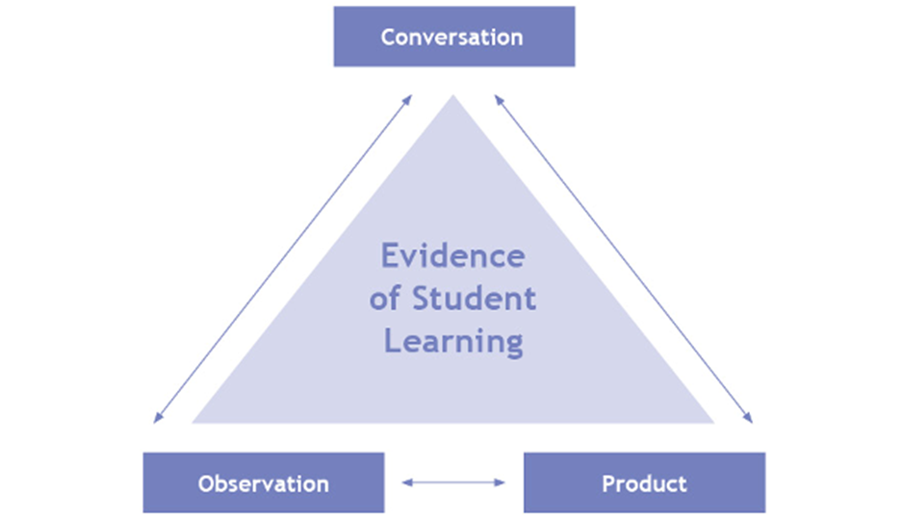

Slide 26
Key Steps in Planning Assessment
Plan the assessment at the same time as you plan the unit
Have clear criteria—and where possible, co-construct the criteria with students
Plan assessment to be on-going, have multiple points where students get feedback, and vary WHO gives the feedback (teacher, peer, self, audience)

Slide 27
DINNER BREAK

Slide 28
Now explore:
Read through the four-pager on your topic area
Explore the activities in the Superlab
Come back to share how you might assess students on these inquiries

Slide 29
Reminders
Science Blog: blogs.sd41.bc.ca/science
Science and Children
Series now repeats:
  Oct 17--Energy
  Nov 15--Organisms
  Dec 4--Forces
  Jan 14--Matter
  February 11--Earth and Water

Slide 30

On The Back of your Name Tag

