Slide 1
Let’s have a conversation visual tracker
This template can be used to help guide students as they learn conversation skills.
Review the conversation goals/rules.
For advanced students, discuss how to repair the conversation if there’s a breakdown.
Start the conversation.
Move the beads onto the pipe cleaners as the students ask questions or make comments.
Produced by Burnaby Speech-Language Pathology Services

Slide 2
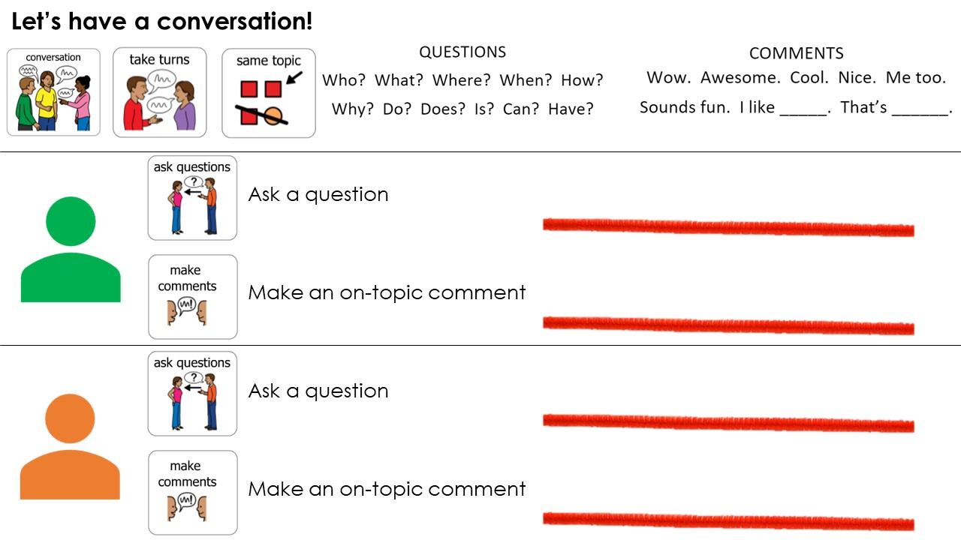
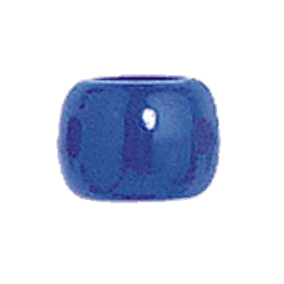
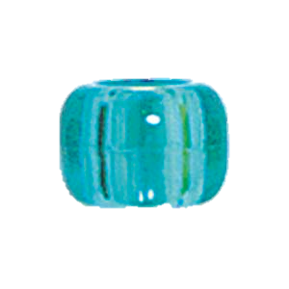

Slide 3
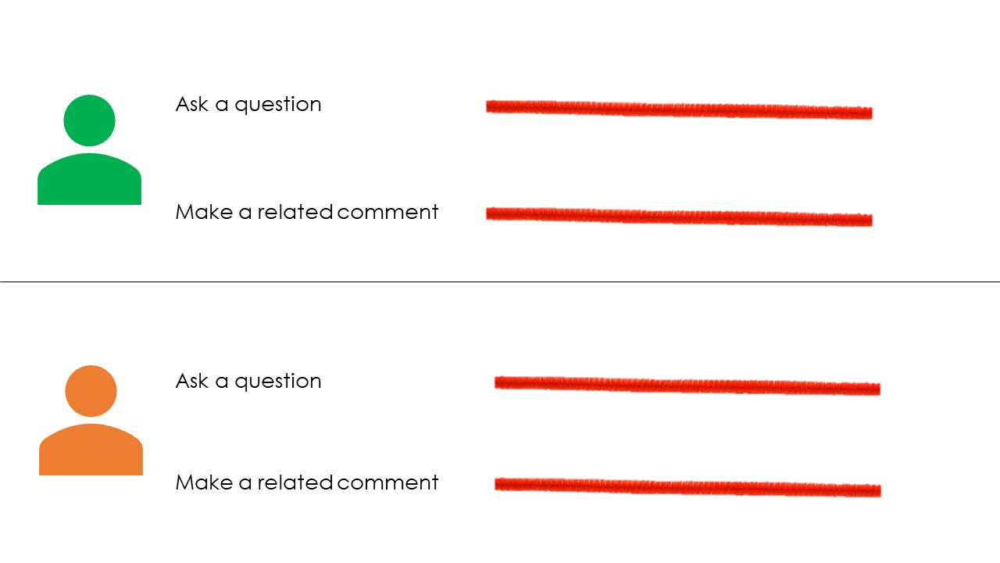

Slide 4
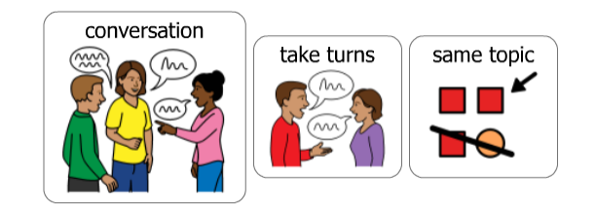
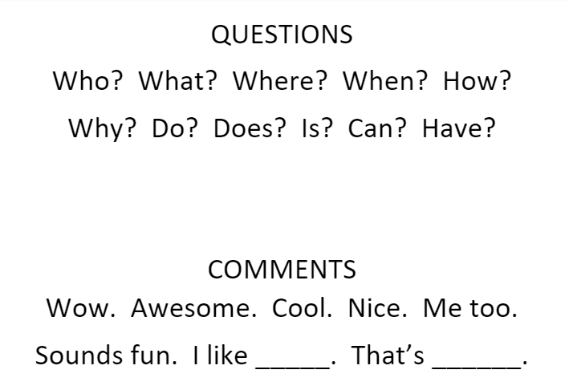



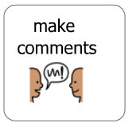

Let’s have a conversation!
Ask a question
Make an on-topic comment
Ask a question
Make an on-topic comment

