Slide 1
Jasper, Kevin and Chris
(\___/)
(=^.^=)
(|)---(|)
present

Slide 2
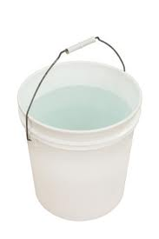
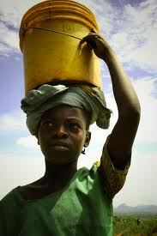
Kenya’s Water Crisis
(Power Point Version)

Slide 3
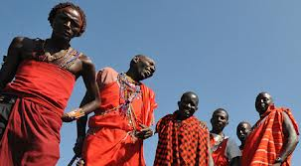
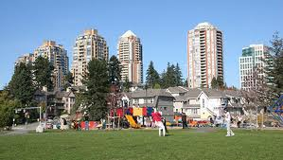
Today we will be answering….
…How does access to clean drinking water affect the quality of life for people living in Burnaby and Kenya

Slide 4
Table Of Contents
(with hyperlinks)
PART 1
Q and A about Burnaby’s water Slide 5
Q and A about Kenya’s water Slide 6
Q and A about Kenya’s water (continued) Slide 7
Quick facts (about Kenya’s and Burnaby's water) Slide 8
PART 2
Comparing Kenya to Burnaby Slide 9
PART 3
What is being to help Slide 10
What can be done to help Slide 11
To sum it up Slide 12
ENDING
Sources Slide 13
Epic ending with credits Slide 14

Slide 5
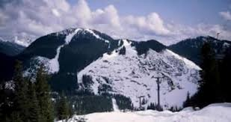

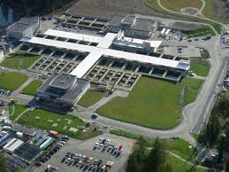
Q and a
(About Burnaby’s water)
Mount Seymour
Q: Where does Burnaby’s clean water come from?
A: Our water comes from Capilano, Mount Seymour, snowmelt and creaks and streams.
A: Our water flows through massive underground networks of pipes, pumping stations, you name it.
Q: How does water reach our faucet?
Did you know?
Your water travels 690 k through sanitation pipes to get to your home.
Q: Where is our water stored?
A: Our government stores our water in reservoirs. Once the water is needed it is pumped into our houses.
Seymour- Capilano filtration plant
Q: How do we treat our clean water?
A: Our water is treated at the Seymour-Capilano filtration plant.

Slide 6
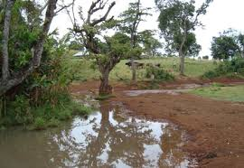
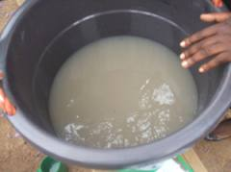
Q and A
(about Kenya’s water)
Did You Know?
Q: Where does Kenya’s “clean” water come from?
A: Some of the lucky people in the city get water pumped directly into a storage tank in there house. When there is a shortage of water the water is rationed. This water comes from two massive lakes in Kenya. For most (the unlucky) they find a random puddle or pond and use that water. Sometimes they will go to a water dealer.
Lack of safe drinking water causes more deaths than war.
Kenya’s “clean” water
Q: How does Kenya’s water reach the faucet?
A: For the lucky people they have water pumped into their storage tank in their house. For the poor they don’t have faucets or sinks. All the water was manually carried in a bucket .
How the poor store water
Q and A continued on next slide

Slide 7
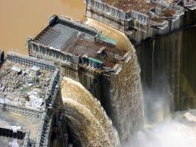
Q and A
(continued)
Did You Know?
Q: how does Kenya treat their “clean” water
A: For the lucky, their water is treated through a system similar to ours however the quality is not that great and the machines frequently break. For most they don’t treat their water at all.
Most Kenyans use only 20 L of water per day while most Canadians use 350 L per day
A dam in Kenya
Q: How is Kenya’s water stored?
A: For the lucky people their water is stored in their water storage tank at their house. However the primary storage place is in dams and reservoirs. For the poor they keep their water in their bucket all day long or in their puddle that they got it from.

Slide 8
QUICKfacts
(or at least I think they are quick)
Canada holds up to 7% of earth’s fresh water.
Toilet water in Burnaby is cleaner then the average bucket of water in Kenya.
In one day the average Canadian uses 329 L of water per person.
In Kenya, fetching water takes up a third of your time.
The average homeless person in Vancouver has better access to clean water than the average Kenyan.
When the average Canadian takes a shower for 5 min you use more then an African uses in a day.
In total, all the women combined spend 200 million hours a day getting water.

Slide 9
Comparing Kenya to Burnaby
What we are comparing | Burnaby | Kenya
Access to education (boys VS girls) | Equal for boys and girls | More girls attend school than boys
Cost of education | free | free
Infant mortality rate | 4 in 1000 | 77 in 1000
Life expectancy | Male: 79 female:82 | Male:63 female:67
Amount of doctors | 1.9 per 1000 (in Canada) | 0.1 per 1000
Average people per household | 2 | 5
Typical type of housing | Apartments or houses | Slums (packed steel boxes)
Major economic industries | Retail trade | Agriculture
Where do most people work | 12% retail trade | 75% agriculture
Unemployment rate | 6.8% | 40%
How many live in urban areas | 100% (there are no rural areas) | 21%
How many live in rural areas | 0% | 79%
How many live per km2 | 2,275 | 70

Slide 10
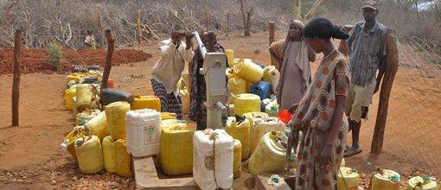
What is being be done to help
Some of the supplies the Kenyans got
Water.org currently supplies Kenya in both urban and rural areas with water filters and many more helpful devices. Here are some of the stats: thanks to water.org 59% of Kenyans now have proper sanitation tools and 32% of Kenyans now have improved access to clean water.
Did you know?
50% of Kenyans live in poverty

Slide 11
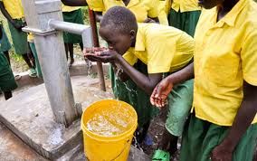
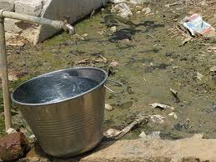
What can be done to help
A water well in Kenya
Dig more wells
Prevents large animals from stepping in the water
More convenient (some even struggle to find mud puddles)
Find builders
Sometimes when the filtration devices break nobody can repair them
This will also help villages to make their own water filters in the future
Supply people with cleaner tools
Buckets being clean or not has an impact on the water being clean
Use proper protection tools on existing wells to prevent rats and roaches falling in the well
Use trucks to haul the water
Water is VERY heavy
Most females spend a lot of time walking to and from their water source
A safe water bucket

Slide 12
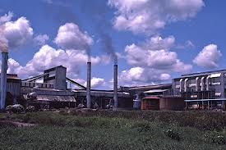
TO SUM IT UP
Did You Know?
Some think it is a coincidence that most poor countries have terrible access to clean water. Have you ever wondered why? Well water is an essential to life. You need water to live. There are many things that we make without even realizing all the water that went into making it. From tires to a pair of jeans you need water to make it. The main reason that Kenya is poor is because they have bad access to clean water.
It takes 2000 gallons of water to make one pair of jeans

Slide 13
SOURCES
Wikipedia.org
Water.org/country/kenya/
Water.org
2 Fact sheets
Burnaby.ca
CIA-the world factbook
Thewaterproject.org
Did You Know?
More people have a cell phone than a toilet

Slide 14
Thank you so much for watching our “epic” PowerPoint. If you liked this a lot you should really see our popplet version.
Credits
PowerPoint made by: Chris
THANKS FOR WATCHING
FOLKS!!!!
The end
Popplet made by: Kevin and Jasper
And Good Bye
Speech made by: Kevin, Jasper and Chris
COPYRIGHT Kevin, Jasper and Chris

