Slide 1
YRCA Nominees
2014-2015

Slide 2
JUNIOR TITLES

Slide 3

http://www.youtube.com/watch?v=Hh5qbE62IyY
http://rjpalacio.com/
Author: R.J. Palacio
Genre: Realistic Fiction

Slide 4
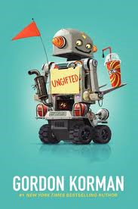
http://www.youtube.com/watch?v=5v1dFNJEQwE
From #1 New York Times bestselling author Gordon Korman comes a hilarious and heartfelt novel in which one middle-school troublemaker accidentally moves into the gifted and talented program—and changes everything. For fans of Louis Sachar and Jack Gantos, this funny and touching underdog story is a lovable and goofy adventure with robot fights, middle-school dances, live experiments, and statue-toppling pranks!
When Donovan Curtis pulls a major prank at his middle school, he thinks he’s finally gone too far. But thanks to a mix-up by one of the administrators, instead of getting in trouble, Donovan is sent to the Academy of Scholastic Distinction, a special program for gifted and talented students.
Although it wasn’t exactly what Donovan had intended, the ASD couldn’t be a more perfectly unexpected hideout for someone like him. But as the students and teachers of ASD grow to realize that Donovan may not be good at math or science (or just about anything), he shows that his gifts may be exactly what the ASD students never knew they needed.
Author: Gordon Korman
Genre: Comedy

Slide 5
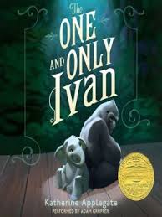
Author: Katherine Applegate
Genre: Animal fiction
http://www.youtube.com/watch?v=UtPdqV2crQ0
http://theoneandonlyivan.com/book/

Slide 6
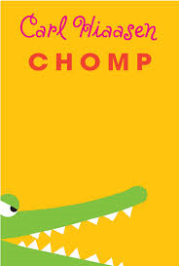
http://www.storysnoops.com/detail.php?id=1399
Author: Carl Hiaasen Genre: comedy/ mystery & suspense

Slide 7
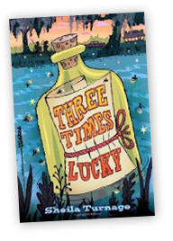
http://www.penguin.com/static/packages/us/yreaders/tupelolanding/
Author: Sheila Turnage
Genre: mystery

Slide 8

http://www.gracelin.com/content.php?page=starryriver
Author: Starry River of the Sky
Genre: fantasy/ (retelling of Chinese mythology)

Slide 9


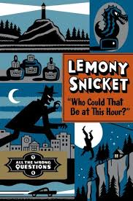
http://www.lemonysnicketlibrary.com/
Author: Lemony Snicket
Genre: mystery

Slide 10

http://sarahm.com/details.php?bid=167
http://www.storysnoops.com/detail.php?id=1455
Author: Sarah Mlynowski
Genre: fantasy

Slide 11
6/7 TITLES

Slide 12

http://goraina.com/books/drama/
Author: Raina Telgemeier
Genre:humour/ realistic fiction

Slide 13
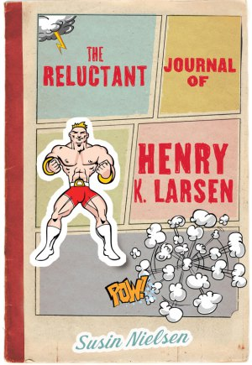
“Thirteen-year-old Henry’s life changes forever when his older brother leaves one morning with their father’s hunting rifle. At his therapist’s suggestion, Henry confides in a journal all his thoughts and his love of the wrestling show Saturday Night Smash-Up.” Darker than her previous novels, Susin peoples this novel about the ultimate cost of bullying with a cast of fabulous characters, dark humour, and a lovable, difficult protagonist struggling to come to terms with the horrible crime his brother has committed.
Author: Susin Nielsen-Fernlund
Genre: contemporary realistic fiction
Subject matter: bullying

Slide 14
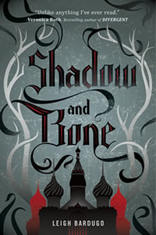
(Book 1 of the Grisha Trilogy)
Surrounded by enemies, the once-great nation of Ravka has been torn in two by the Shadow Fold, a swath of near impenetrable darkness crawling with monsters who feast on human flesh. Now its fate may rest on the shoulders of one lonely refugee.
Alina Starkov has never been good at anything. But when her regiment is attacked on the Fold and her best friend is brutally injured, Alina reveals a dormant power that saves her life—a power that could be the key to setting her war-ravaged country free. Wrenched from everything she knows, Alina is whisked away to the royal court to be trained as a member of the Grisha, the magical elite led by the mysterious Darkling.
Yet nothing in this lavish world is what it seems. With darkness looming and an entire kingdom depending on her untamed power, Alina will have to confront the secrets of the Grisha… and the secrets of her heart.
Author: Leigh Bardugo
Genre: fantasy/ adventure
http://www.leighbardugo.com/shadowandbone/

Slide 15
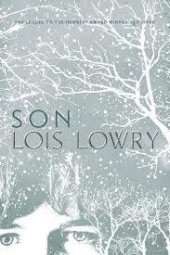
Son is the fourth book in The Giver Quartet by Lois Lowry. It was preceded by Messenger, the third book of the series. The book follows Claire, the mother of Gabriel, the baby seen in The Giver.
http://www.youtube.com/watch?v=aNf_pwgBeOQ
Author: Lois Lowry
Genre: dystopian

Slide 16

http://www.rebeccasteadbooks.com/liarandspy.html
Author: Rebecca Stead
Genre: realistic fiction

Slide 17

2013 Newbery Honor Book
2013 Sibert Award Winner
2013 YALSA Excellence Winner
A gripping narrative of the race between countries, spies, and scientists to create the first atomic bomb.
Author: Steve Sheinkin
Genre: nonfiction

Slide 18

http://www.marissameyer.com/book/book-one/
Author: Marissa Meyer
Genre: dystopian fiction

Slide 19

http://maggiestiefvater.com/blog/the-animated-book-trailer-for-the-raven-boys
http://maggiestiefvater.com/the-raven-boys/
Author: Maggie Stiefvater
Genre: fantasy

